Slide 1
Rural Fuel Poverty
Dr. Jane Hart

Slide 2
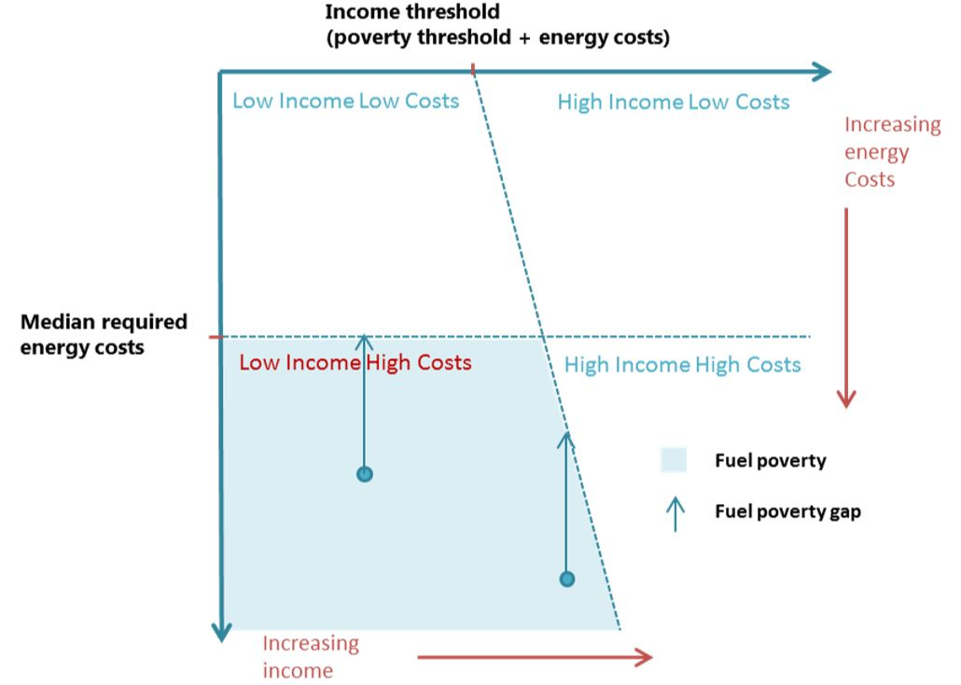
The official definition of fuel poverty in England
uses the Low Income High Costs (LIHC) indicator.
A household is considered to be fuel poor if:
they have required fuel costs that are above average (the national median level)
were they to spend that amount, they would be left with a residual income below the official poverty line (which is defined as being below 60% of the median household income.)
The fuel poverty gap is a measure of the additional income which would be needed to bring a fuel poor household to the point of not being fuel poor.

Slide 3
The 3 main factors that influence whether a household if fuel poor
household income
household energy requirements
fuel prices

Slide 4
Typical characteristics of fuel poor households
A much lower income after housing costs (£10,325 fuel poor, £24,050 not fuel poor)
Higher fuel costs (median annual costs fuel poor £1366, £1140 non fuel poor)
Less energy efficient homes. Rural homes twice as likely to be bands E-G

Slide 5
Rural Fuel Poverty
..is both more prevalent and more acute than urban
Approximately 13% of household in rural villages and hamlets are fuel poor compared to 11% of urban households
Average fuel poverty gap in 2016 was more than twice as high in rural villages, hamlets and isolated areas (£625) as in urban (£289).

Slide 6
Why is fuel poverty worse In rural areas?
Lower workplace earnings
Rural homes twice as likely to have poor thermal efficiency (bands E-G)
Fuel prices. Mains gas is available to only 41% of rural homes (90% of urban). 15.5% of households with no mains gas are fuel poor compared to 10.4% of those with mains gas.
.

Slide 7
Issues with unmetered fuels
More expensive than mains gas
Variations in costs (often seasonal or related to supply issues)
Significant up-front charges, often for bulk amounts
No ‘Priority Services Register’ for those vulnerable to loss of
fuel supply
Often a limited choice of suppliers
Difficulty in comparing prices (no comparison websites)
“A lack of competition and insufficient protection for the vulnerable” (Baker and Faulk)

Slide 8
Key policy issues and tensions
Energy company obligations are not required to specifically target areas ‘off mains gas’.
Rural fuel poor households are more scattered and difficult to identify so obligated companies are likely to concentrate on small towns and larger villages rather than remoter rural.
No priority services register for vulnerable households using LPG and Oil.
Conflating carbon reduction and fuel poverty reduction objectives can disadvantage those unable to access mains gas.
Park homes a particular issue - rarely eligible for national insulation schemes.

