Slide 1

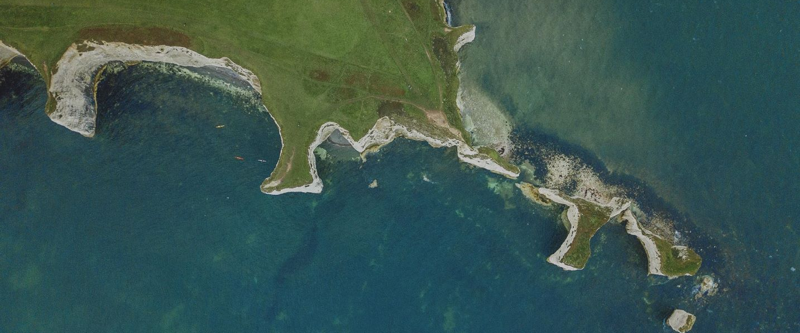
Rural and coastal transformation – Lincolnshire System
Jenny Makwana
HEE Associate Workforce
Transformation Lead
Developing health, care and communities through
workforce, education, and training in small places
Notes:
My name is Jenny Makwana and I am an Associate Workforce Transformation Lead for the Lincolnshire system, Nottinghamshire system and supporting with the Rural & Coastal Pilot in Lincolnshire.
Just to give you some background……..
In Sept 2021 a rural discussion paper was published by colleagues in HEE. The paper highlighted the global, national and local research on workforce, education and training in rural and coastal communities. The paper set out an ambition to build a defined programme offer in these areas, helping to reduce ill health and health inequalities in rural areas through educating, training and digitally enabling the health and care workforces.

Slide 2
“The most successful model of education and training for local comprehensive Public Health Care is socially accountable, immersive community-engaged education woven into a facilitated education and training pathway starting with recruiting local students from rural and underserved communities.”
Strasser, Roger; Strasser, Sarah. 2020.
Reimaging Primary Health Care Workforce in Rural and Underserved Settings.
Health, Nutrition and Population Discussion Paper; World Bank, Washington, DC.
Professor Roger Strasser is New Zealand's first Professor of Rural Health, leading the University of Waikato's Rural Health Public Engagement, including public education about rural health and advocacy for rural health, as well as community engagement at the local level.
Notes:
Compelling data from Canada, North America and Australia highlight the need to train and retain medical students who have followed a rural track Programme.
Strasser demonstrated that 30% of students from the Northern Ontario School of Medicine continue into specialty training in that geography, making training in rural areas an essential aspect of this offer.
It is necessary to establish a pathway preferencing students from rural backgrounds onto healthcare courses.

Slide 3
Lincolnshire as a Pilot
Rural communities are ageing more rapidly than urban areas.
Younger population tends to decline the more rural the settlement type.
Older people experience worse health and have greater need of health and care services.
Access to health and care services is often poorer than in urban settings.
Health outcomes are also poorer in coastal areas. The pleasant environment attracts older, retired citizens to settle, who inevitably have more and increasing health problems. An oversupply of guest housing has led to Houses of Multiple Occupation which led to concentrations of deprivation and ill health.
Notes:
Classifying rural and coastal communities
The Rural Urban Classification is a national statistic used to distinguish between urban and rural areas. Using this classification, 9.6 million people, or 17.1% of the population, lived in rural areas in 2019.
Taking account of deprivation factors, HEE has combined data on rural and coastal workforce distribution with the Index of Multiple Deprivation. This identified four areas with low workforce levels for doctors & nursing, with high deprivation levels.
Lincolnshire, Norfolk & Waveney, Suffolk & North East Essex, and Kent & Medway.

Slide 4
What do we know?
Successful rural workforce transformation requires:
Commonality, as rural communities identify more with similar communities in other countries than their own urban centres.
Delivering education and training within rural communities increases the quality and cultural relevance of services through a lived experience.
Investing in targeted training of rural residents increases recruitment and stability of services in rural locations.
Initiatives must be co-produced with the local population to be successful.
HEE investment in a rural and coastal programme allows education and training to act as a catalyst for change in developing a workforce skilled to meet the health and care needs.
Notes:
Being rural and coastal is not new for Lincs and we are always developing transformative solutions to our R&C WF challenges, however we now have a real opportunity as HEE has recognised through the data (on deprivation, workforce, digital data and current activity) and research that a rural and coastal programme that aligns to the HEE strategic goals, objectives and Business Plan is required.
A funding pot has been secured for the Lincolnshire pilot and a strategic oversight Group created to support the ambitions and strategic plans for the ICS R&C programme.
The funding is to support the core and place based objectives and to look at transformational projects we can implement as a system in the medium to long term.

Slide 5


The medical offer
Developing a ‘Specialist Generalist’
within rural health and care settings.
Approximately 80% of doctors completing specialty
training settle within 50 miles of the area they trained.
Priorities:
  equitable training investment
  redistributing training posts
  learning experiences and support in rural settings
A new Doctor (Medical) Apprenticeship route. Opportunities for apprenticeships in the most challenged remote and rural areas.
Notes:
Evidence emphasises the need for developing a ‘multi skilled professional’ and support workforce with generalist skills on the widest practicable basis amongst health and social care workers in rural areas.
Creating a Generalism enhanced leadership and social medicine programme, will influence the approach to medical and clinical training in England. Trailblazer Sites are Derbyshire, Lincolnshire & Coventry.
The ultimate aim of the project is to educate IMTs to become more ‘generalist’ and holistic in their approach to the management of patients, treating the person rather than the disease. It will allow them to create community links they can then use for the rest of their training and into their consultancy posts. They will also have a unique QI project and a better foundation in research.
The Medical Doctor Degree Apprenticeship-People wanting to train as a doctor could achieve their degree by an apprenticeship route from September 2023, which aims to widen access and participation in undergraduate medical education and deliver better care to patients through a diverse workforce that is more representative of local communities.
Hygiene Factors-ULHT are also a Pilot site for a hygiene factors project looking at developing innovations to attract, recruit and retain our medical workforce in R&C areas of the ICS. Felicity Begley WTM for Lincs is also undertaking an MBA research project covering the Factors Influencing Doctors’ In training Career Decision-Making to address Rural and Coastal Workforce Issues (these findings will be available in March 2023).

Slide 6

The TEL offer
Specialist rural health e-LfH packages.
Adoption of new immersive technologies and virtual learning
environments to support learners across large geographical areas.
The Knowledge and Library Services offer
Leading health and digital literacy and patient
information activity with local communities.
Notes:
A quarter of the population in Lincolnshire do not posses the skills to confidently use technology or digital products in their lives.
• A large proportion that have no motivation to engage with the internet.
• The key area of focus is to increase the motivation to engage with barriers and opportunities within this area.
• This requires a workforce and the public being able to have great conversations about the use of digital products in the provision of care.
HEE National are supporting NHS Lincolnshire Community Health Services to develop a 12 month programme to create ‘Digital Ambassadors’ across the workforce and communities of the east coast, Lincolnshire.

Slide 7
Advanced Clinical Practice and AHP
AHP services optimising rehabilitation, functional independence and mental health recovery.
AHP apprenticeships (from support workforce to ACP across the AHP professions).
Support in rural areas offers several workforce solutions supporting clinician retention through skills expansion, career enhancement and multi-disciplinary team leadership.
Flexible and adaptable workforce solutions, especially for primary care.
Notes:
Looking at our ACP offer, we already have in the Lincolnshire system the ACP rotational fellowship which launched in 20/21.
The HEE faculty for Advancing Practice is keen to work with the system to see how this can be developed to become a sustainable rotation and align to system priorities, including rural and coastal.
Separate to the R&C pilot we have been successful in a bid for 100k to support the development of a Lincs ICS ‘school/academy for AP’ as a proof of concept in 22/23 so we need to see how this pilot can contribute to the RRC transformation programme.

Slide 8

Impact and delivery
Recognition that education and training supports recruitment
and retention of health professionals through innovation,
cultural changes, visible investment and career opportunities.
Sustainable workforce transformation capacity in all ICS’.
Support delivery of a workforce reform prioritisation plan.
Increase local student intake working with ICS host medical schools,
through widening access initiatives, to more than 30%. (Strasser).
Notes:
Successful rural workforce transformation requires:
Commonality, as rural communities identify more with similar communities in other countries than their own urban centres.
Delivering education and training within rural communities increases the quality and cultural relevance of services through a lived experience.
Investing in targeted training of rural residents increases recruitment and stability of services in rural locations.
Initiatives must be co-produced with the local population to be successful.

Slide 9
Progress to date
HEE 22/23 Programme Funding of 250k approved (focus on digital, apprenticeships and widening participation, medical and dental workforce, advanced practice workforce)
Strategic Oversight Group for external project leads. Also setting up a HEE Midlands internal Strategic Oversight Group.
Engagement with HEE national team, and regional pilot leads to share learning.
Local stakeholder engagement (NHS, UoL, TH/PC, LIVES, LA)
Linking with NCRHC and LIIRHC
Guest Lecture with Professor Roger Strasser, who will delivering an overview of his widely appraised Rural Workforce Research, at the University of Lincoln Medical School in Nov 2022.
Aim to launch the Lincs ICS R&C ambitions (Nov 2022) and Lincs ICS R&C WF Strategy (Mar 2023) through this strategic oversight group

Slide 10
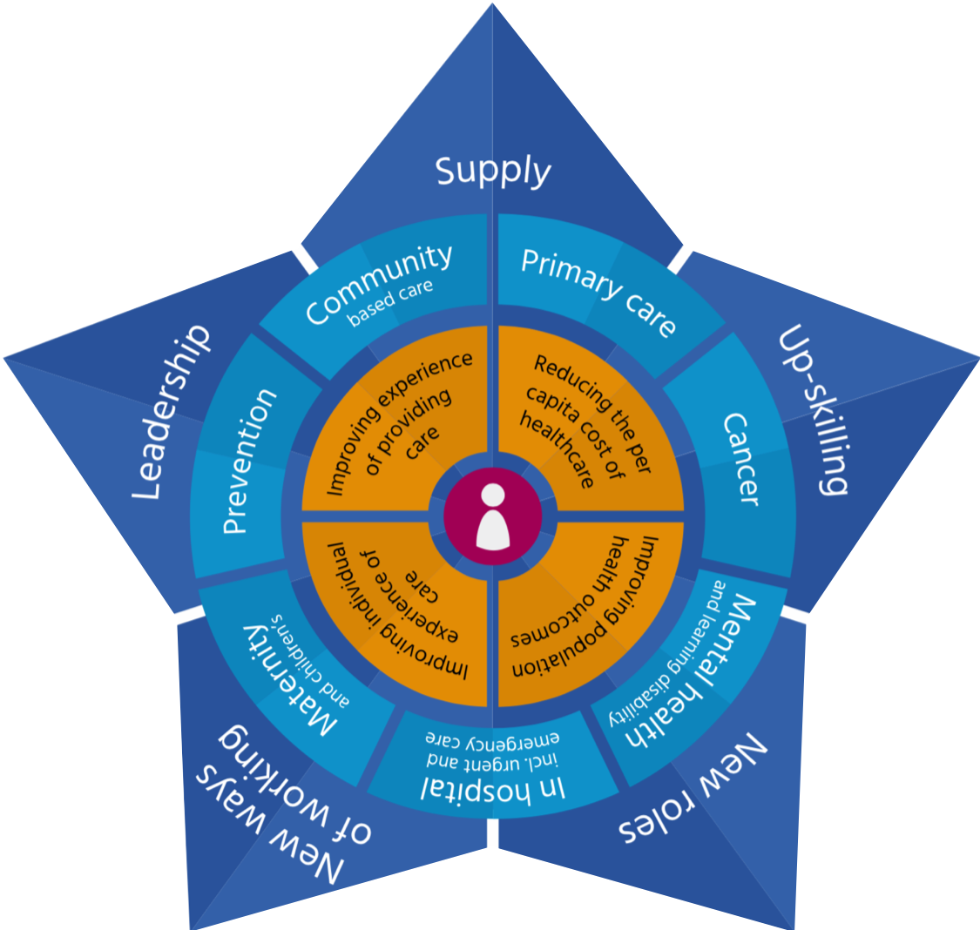
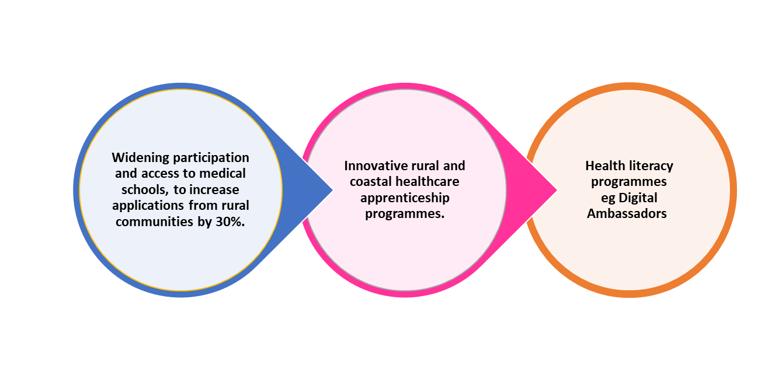
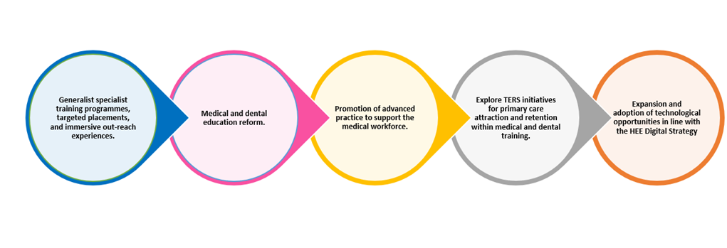
Objectives
Core
Using the HEE STAR and other planning tools, work with the ICS and local providers to determine priority interventions.
Place-based
Using the HEE STAR and other planning tools, work with the ICS and local providers to determine priority interventions.

