Slide 1

Helping to inform and engender better rural policy making by:
Providing independent research and evidence
Supporting rural information exchange
Building a network of rural stakeholders
Contact us: info@ruralengland.org

Slide 2
State of Rural Services 2018
What is it? Why produce it?
The way services are delivered and used is quickly evolving
What does this mean for rural people and business?
Having this understood and debated should inform policy making
As well as assisting better policy delivery
Encourage others to help fill rural evidence gaps
A resource presenting facts and statistics about rural service provision
Pulling out some over-arching service trends
Collating existing, recent rural evidence
Adding some secondary (rural) analysis of data
Noting important gaps in the evidence base

Slide 3
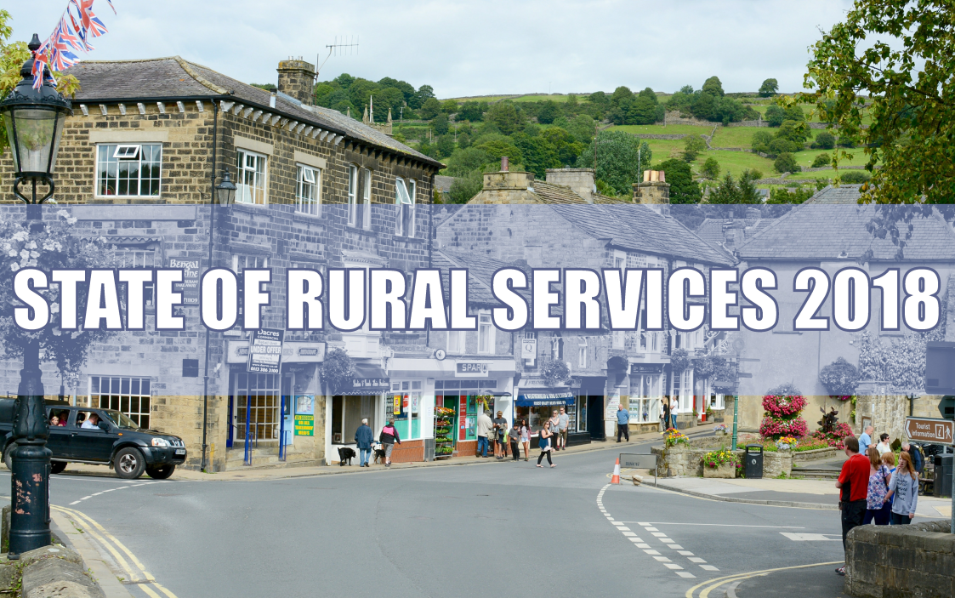
A rural exploration of the state of:
Local buses and community transport
Broadband and mobile connectivity
Public library services
Hospitals
Public health services
Young people’s services
Shops and online shopping
Personal advice services
Download the full report at:
https://ruralengland.org

Slide 4
Many services contracting in rural areas
Most notably those delivered by local government which are discretionary
Subsidised bus services:
Youth clubs or centres:
Four rural shires no longer subsidise any bus routes
202 shire bus routes were withdrawn and 191 scaled back in 2016/17
Bus passenger numbers fell (-7%) from 2014 to 2016 in predominantly rural areas
Shire local government spend on young people’s services down 38% in three years
Many local authorities no longer fund youth clubs
Some youth clubs adapted and survive, whilst others have closed

Slide 5
Public funding for services
Nearly always lower in rural than in urban areas
“This poses a question about the equity of service provision to rural communities. Indeed, the extent of the funding variation sometimes raises a linked question, whether it can actually be justified by levels of service need.”
Based on spend per resident in 2017/18. Predominantly rural areas compared with predominantly urban areas.
Bus subsidy | 39% less
Discretionary concessionary fares | 78% less
Public health | 36% less
Library services | 25% less

Slide 6
Digital connectivity
Rural coverage is improving, but it still lags behind
Broadband (fixed line):
Mobile networks:
2018 figures | Rural areas | Urban areas
Average download speed | 34 Mbps | 52 Mbps
Have access to 10 Mbps (USO level) | 89% of premises | 99% of premises
Have access to 30 Mbps (superfast) | 76% of premises | 97% of premises
2018 figures | Rural areas | Urban areas
Phone call possible on all networks | 67% of premises | 97% of premises
4G possible on all networks | 42% of premises | 83% of premises
Phone call geographic coverage | 90% of area | 99% of area

Slide 7
Changing healthcare provision
How rural proofed are the NHS Sustainability & Transformation Plans?
Common STPs aims:
Reduce hospital capacity
Reconfigure acute services
Review specialised services
Redesign community and primary care services
Improve mental health services
The four shire STPs reviewed indicate that:
Rurality was rarely an explicit consideration
But scope for locally-based services frequently was
Hospital services are being centralised for medical safety and cost reasons
Only one STP weighed this against geographic access

Slide 8
Public health outcomes
Do services meet the needs of rural young people?
Young people in rural areas score better than average on:
+ School exclusions
+ Emotional and mental health needs
Young people in rural areas score worse than average on:
- Risky behaviours
- Alcohol consumption
- Smoking
- Being bullied

Slide 9
Community-run rural services
High expectations of communities and volunteers
Community-run Shops
- about 300/nearly all rural
Community-managed Libraries
- 10% libraries/most rural
Community Transport Schemes
- 52% mainly serve rural
Volunteer-run Youth Clubs
- 12% rural based
Can deliver benefits:
Broader service offer
Better opening times
But there can be risks:
Volunteer capacity limits
Places lacking volunteers with skills and time
Sustainability, where grant-dependent

Slide 10
Widening the service offer, co-location and service hubs
Rural convenience stores:
53% give cash back
44% host an ATM
32% have a PO counter
Community-run shops:
43% include a cafe
Community-run libraries:
25% offer IT access
19% have a room for hire
17% host cultural events
Benefits likely to include:
Cost savings for the service providers
Increased footfall at the service facility
Added convenience for the service users

Slide 11
Rural services evidence base:
Four key gaps have been identified
Accessibility statistics – the existing access data measures too narrow a range of services
Big trends – to think through rural implications of more online services, struggling high streets, an ageing population, etc
Policy reforms – to evaluate rural impacts e.g. NHS Sustainability & Transformation Plans
User impacts – to find out what rural users do if bus routes disappear, bank branches close, etc

Slide 12

Read the report or its summary at: https://ruralengland.org

