Slide 1

Creating a Community Facility and Building Affordable Homes
Notes:
Introduction re: Vanguard, Voids and Lettings, in addition to the Vanguard Intervention Team a further 50 colleagues have attended awareness sessions (Tony)

Slide 2
Connexus
Over 10,000 homes across Herefordshire and Shropshire
Wellbeing and Support services in Gloucestershire
Largest 5 telecare provider in UK – 38,000 connections nationally

Slide 3

Neenton, Shropshire
52 households, 145 people
Village pub ‘The Pheasant’ closed in 2006
No village hall / shop / post office
Soon no community?
Neenton Community Society

Slide 4
Community Ambitions
Affordable homes for local people
Village Inn with long term future
Community facilities
Local employment

Slide 5
Ambitions into Action
Partnership with South Shropshire HA
Loan from SSHA to NCS to buy land and refurbish pub
Planning granted as Community Led Scheme
5 open market / 2 shared ownership
Funding from sales / HCA grant repaid loan

Slide 6
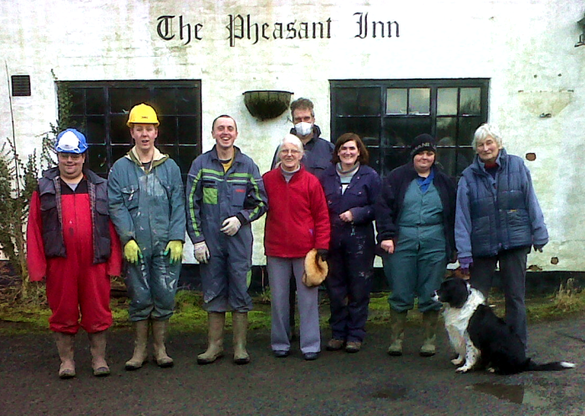

Slide 7

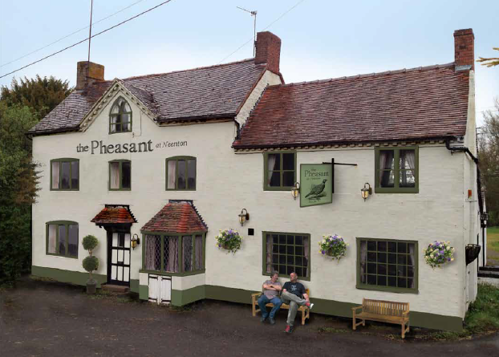

Slide 8
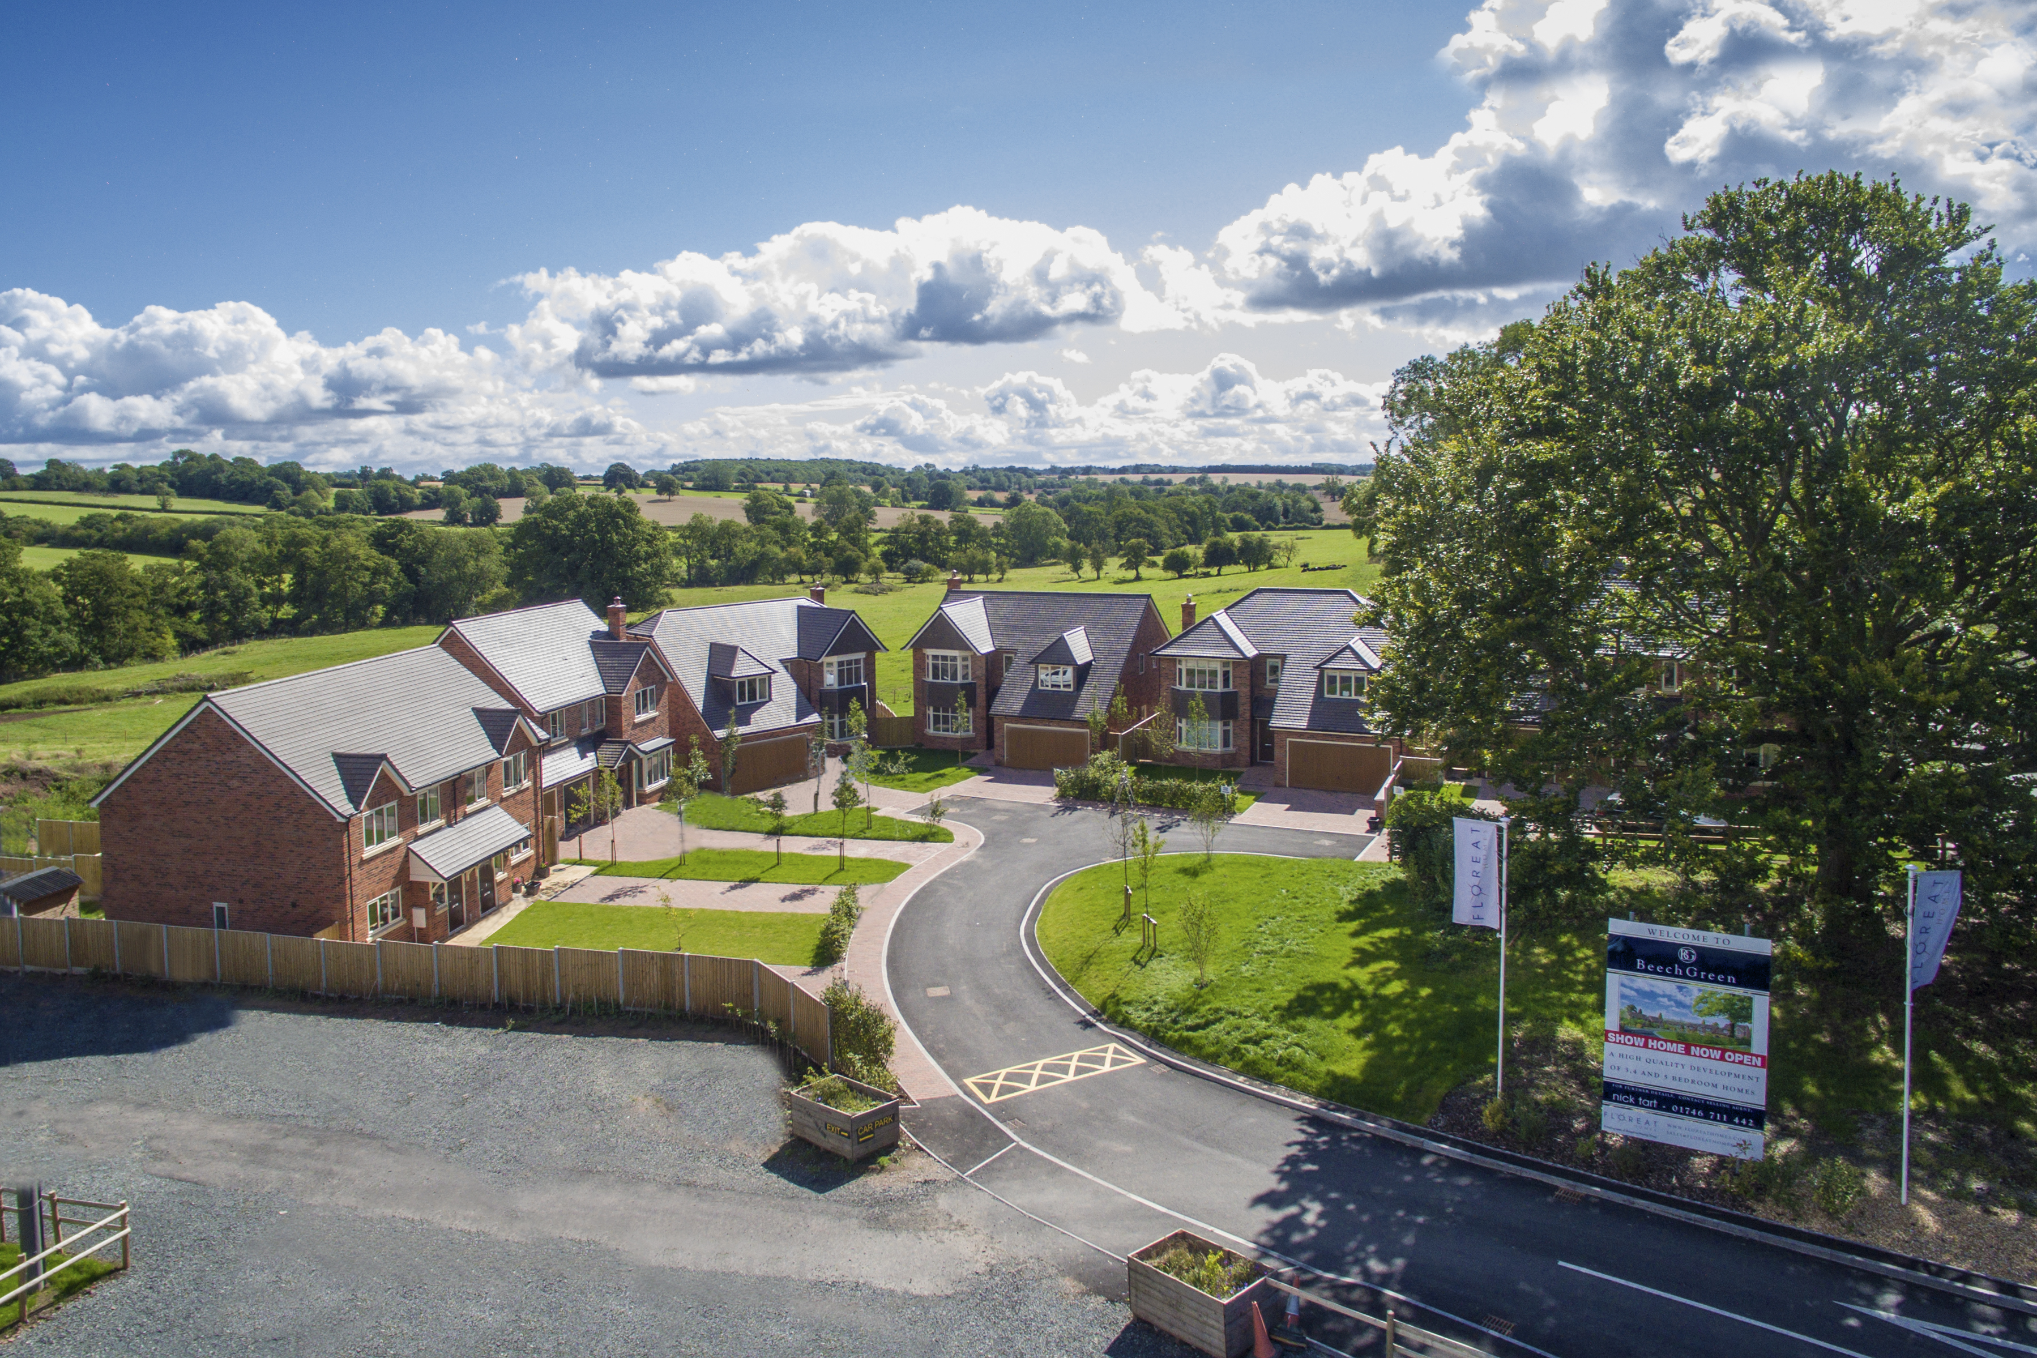

Slide 9
What the planners said
Fantastic scheme, should be commended, provides housing for local people and community facility
Great scheme, blue sky thinking, each house looks different, typical of a village, a development to be proud of
can’t wait for it to be built and have a drink there

Slide 10
