Slide 1
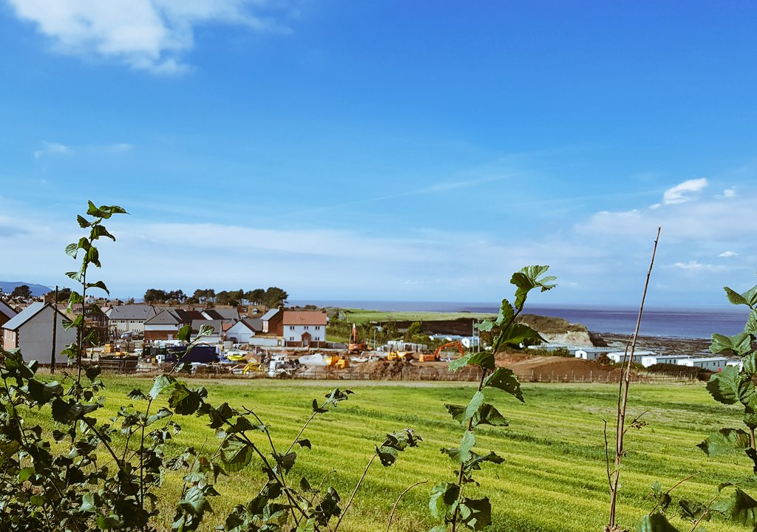

Slide 2
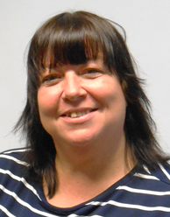

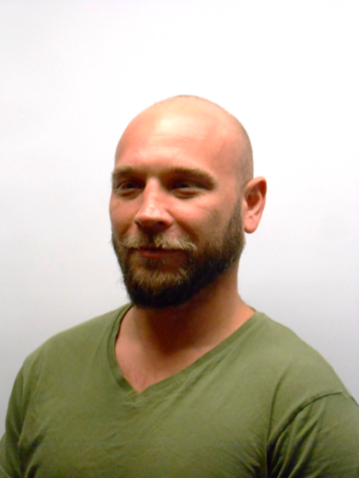
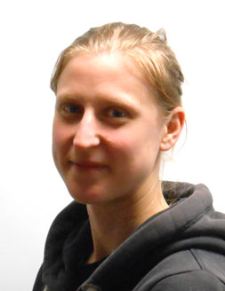

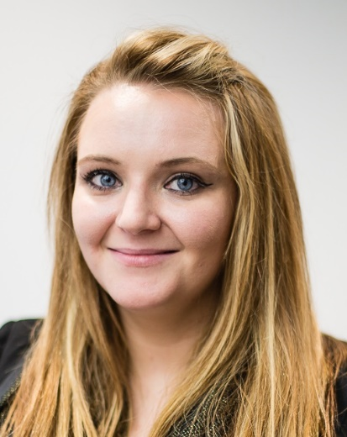
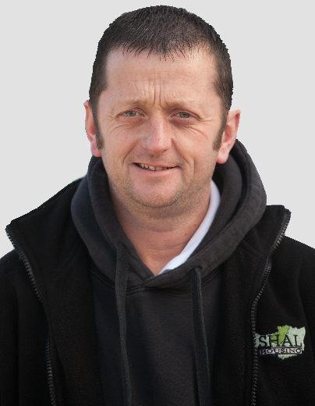
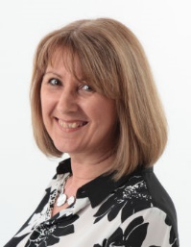


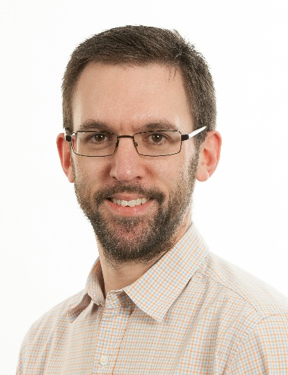
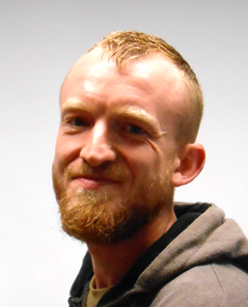
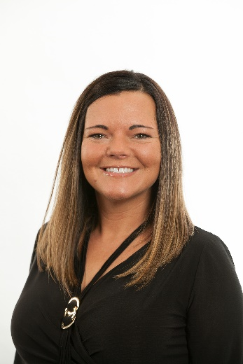
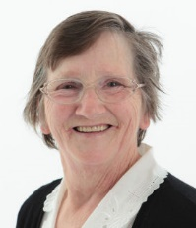
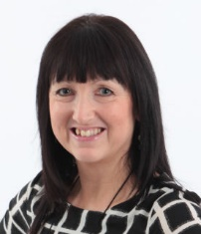

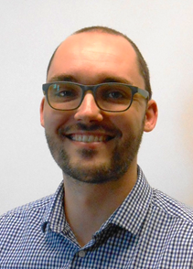
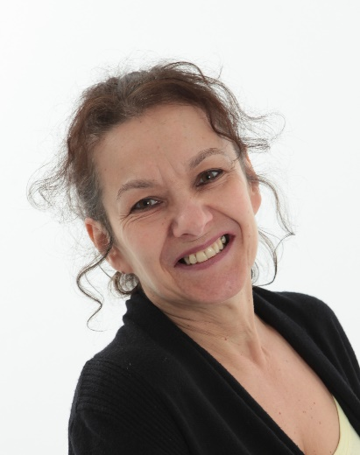
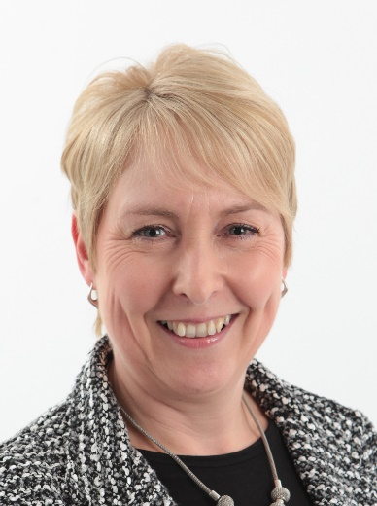
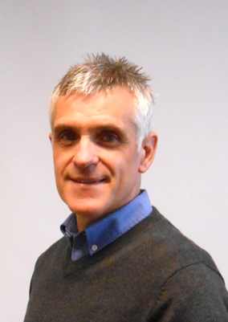

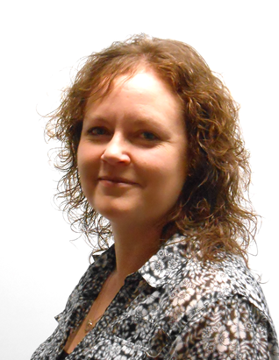


Slide 3
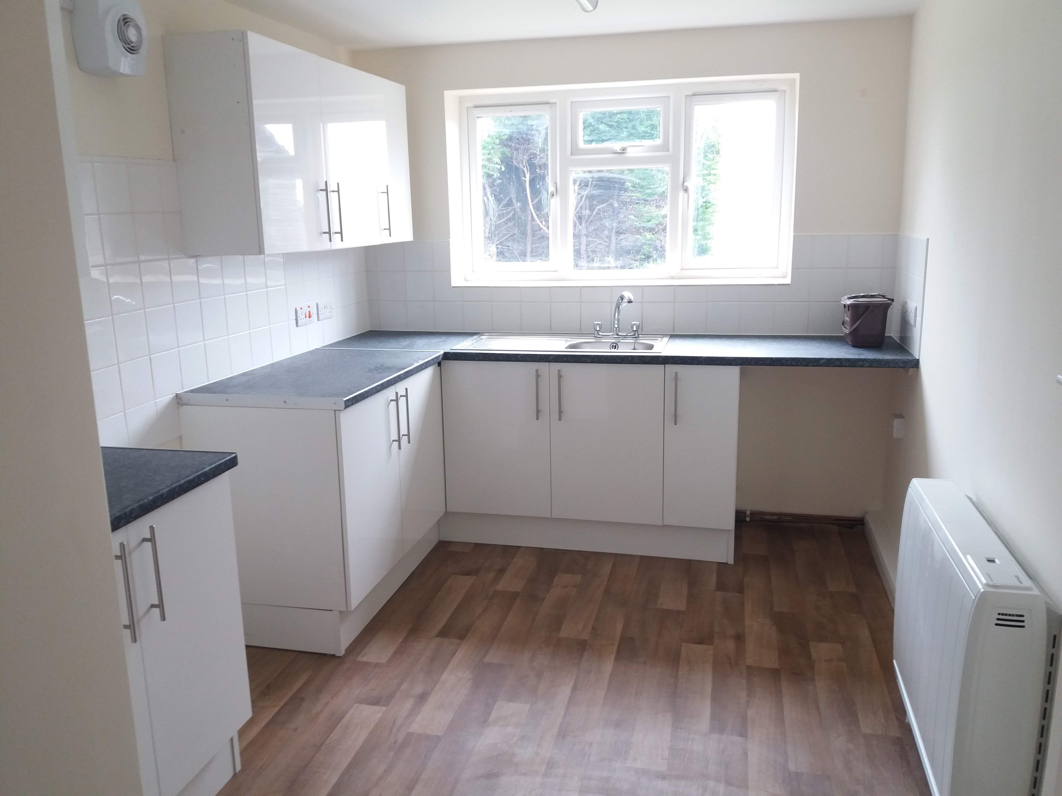

Slide 4
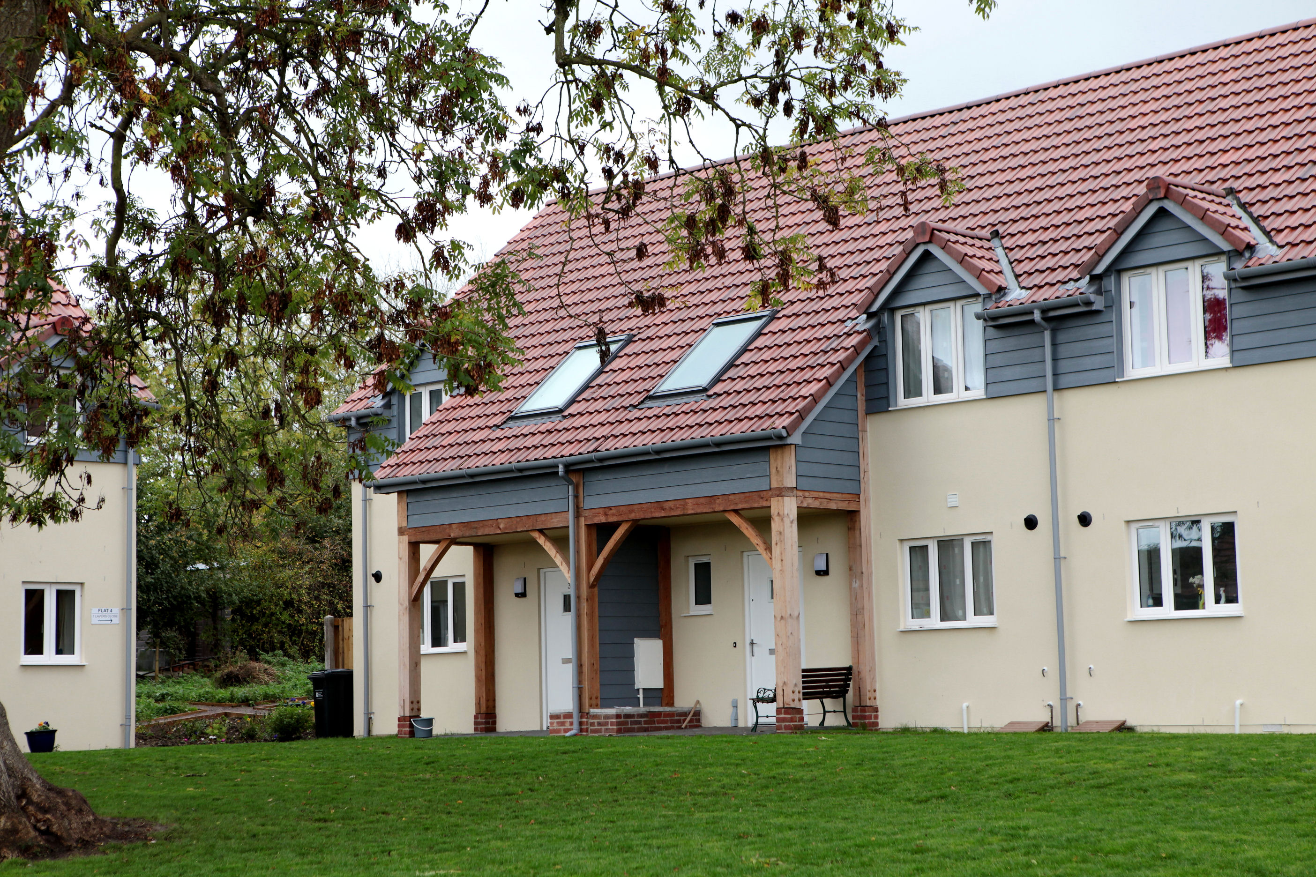

Slide 5
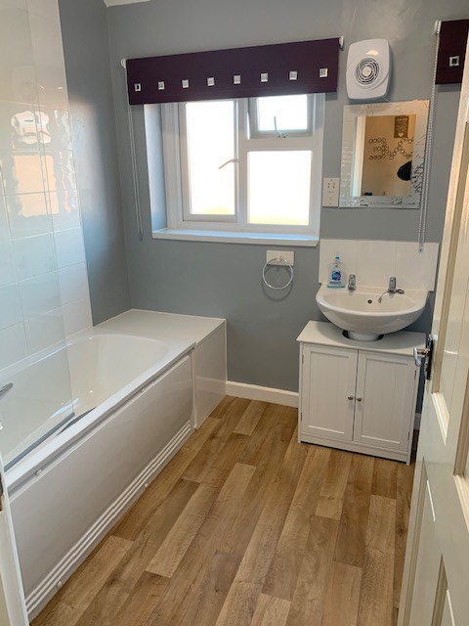
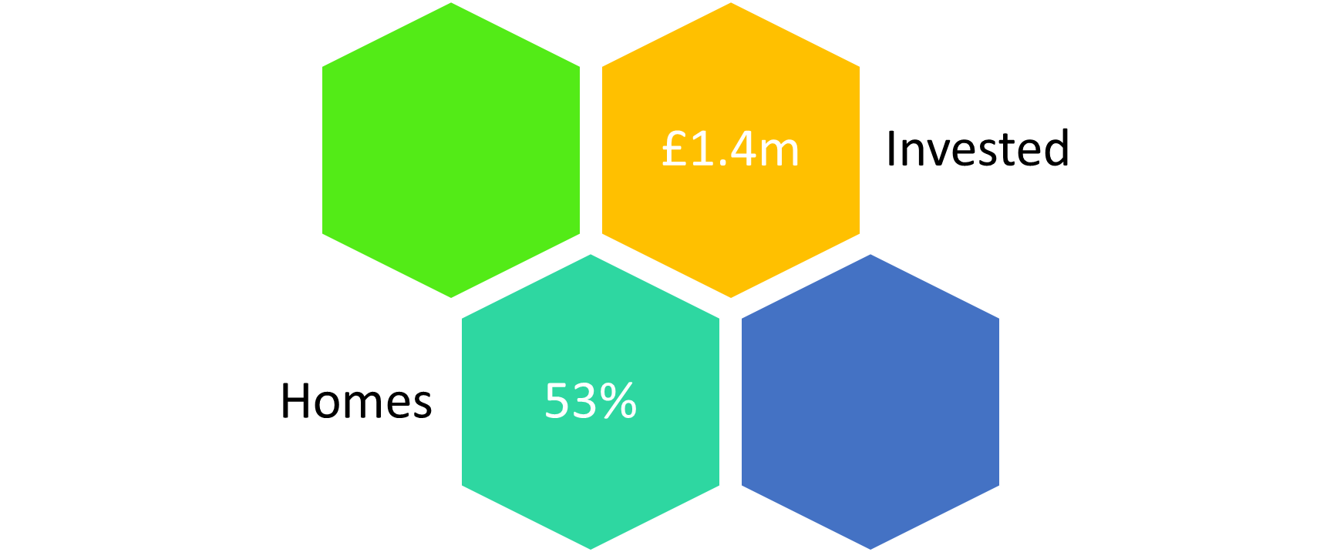

Slide 6
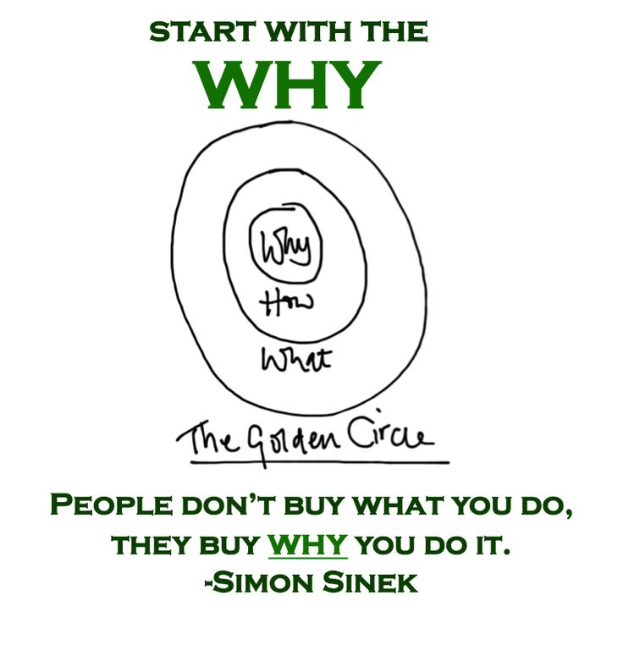

Slide 7
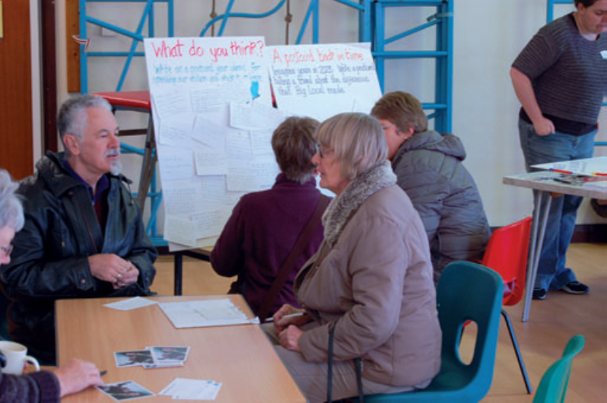
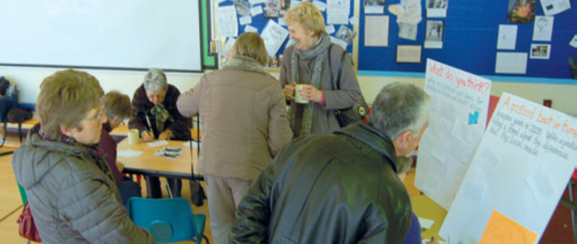
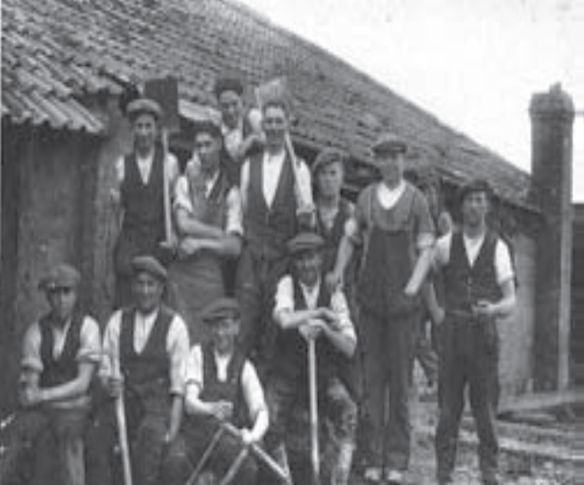
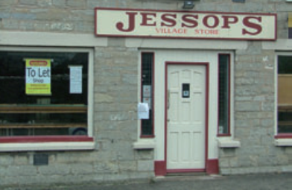
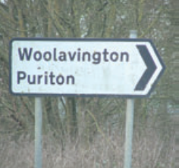
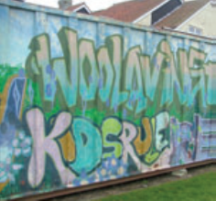

Slide 8
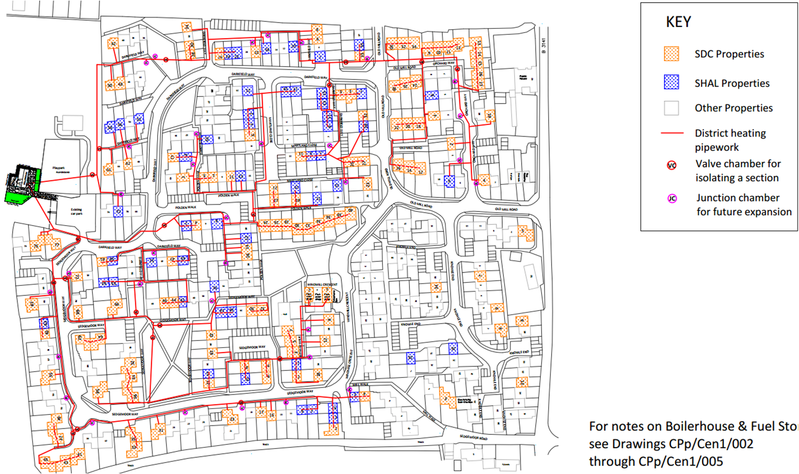

Slide 9
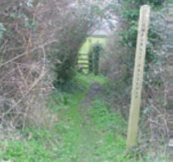
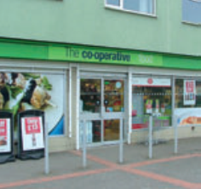
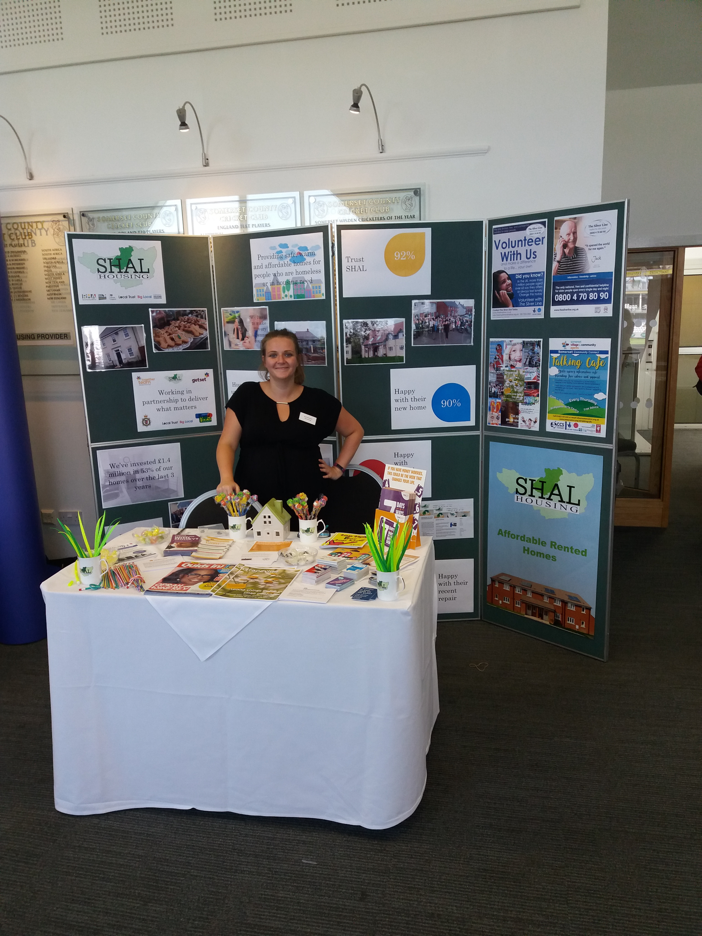
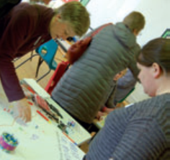
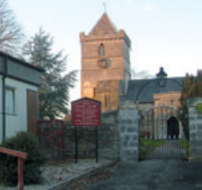




Slide 10

Payment | 1 | 2 | 3 | 4
Payment date | January 2019 | July 2019 | January 2020 | July 2020 | Total per activity
Tackling loneliness | £1,500.00 | £18,500.00 | £39,000.00 | £41,000.00 | £100,000.00
Transport | £3,250.00 | £11,750.00 | £17,250.00 | £17,750.00 | £50,000.00
Support for young people | £6,000.00 | £14,000.00 | £41,000.00 | £41,000.00 | £102,000.00
Communications and engagement | £17,000.00 | £8,000.00 | £13,000.00 | £12,000.00 | £50,000.00
Community facilities | £23,500.00 | £26,500.00 | £80,500.00 | £169,500.00 | £300,000.00
Community grants | £15,200.00 | £4,800.00 | £12,800.00 | £12,200.00 | £45,000.00
Core costs | £17,240.00 | £17,760.00 | £18,240.00 | £17,760.00 | £71,000.00
Emerging projects | £0.00 | £8,500.00 | £6,000.00 | £8,000.00 | £22,500.00
Contribution to support grant administration and partnership running costs | £4,184.50 | £5,490.50 | £11,389.50 | £15,960.50 | £37,025.00
TOTAL inclusive of VAT you cannot recover | £87,874.50 | £115,300.50 | £239,179.50 | £335,170.50 | £777,525.00

Slide 11
Power
The ability to get things done

Slide 12
How power is defined is changing
Old power
Held by a few
Leader driven
Secretive
Enabled by what people know, control that others don’t
Taps into consumption
New power
Made by many
Open and participatory
Peer-driven
Transparent
Don’t hoard it channel it
Goes beyond consumption

Slide 13

THE PACT
POWER – A SHIFT TO THE COMMUNITY
ACCOUNTABILITY – TO THE COMMUNITY
CONNECTION – DEEPER AND CLOSER
TRUST – THE MOST IMPORTANT COMMUNITY ASSET

Slide 14
‘In SHAL Housing I can see that you have a high quality Locally Trusted Organisation which is committed to helping you to be as effective as possible.’
Mohamed Mohamud @localtrust.org.uk

Slide 15
Today, the wisest organisations will be those engaging in the most painfully honest conversations, inside and outside, about their impact.

