Slide 1
Rural Vulnerability Day
Southwold Community Hospital Project

Slide 2
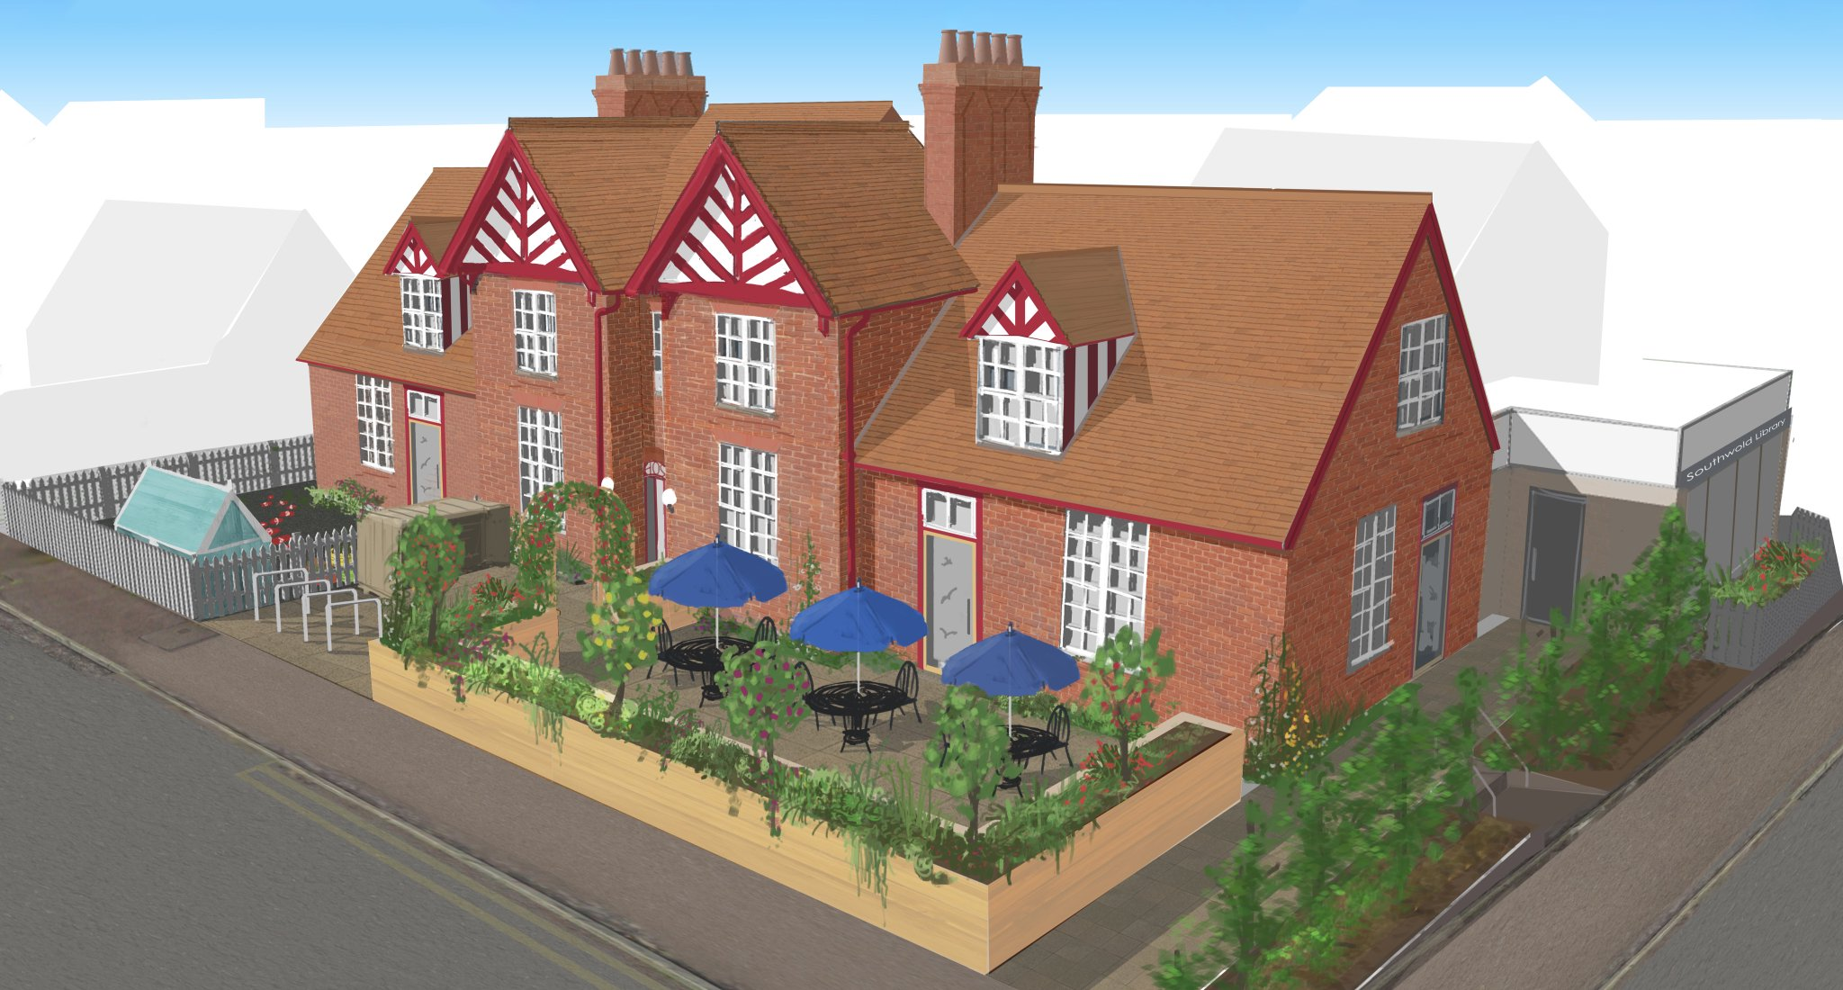
Southwold Community Hospital Project

Slide 3
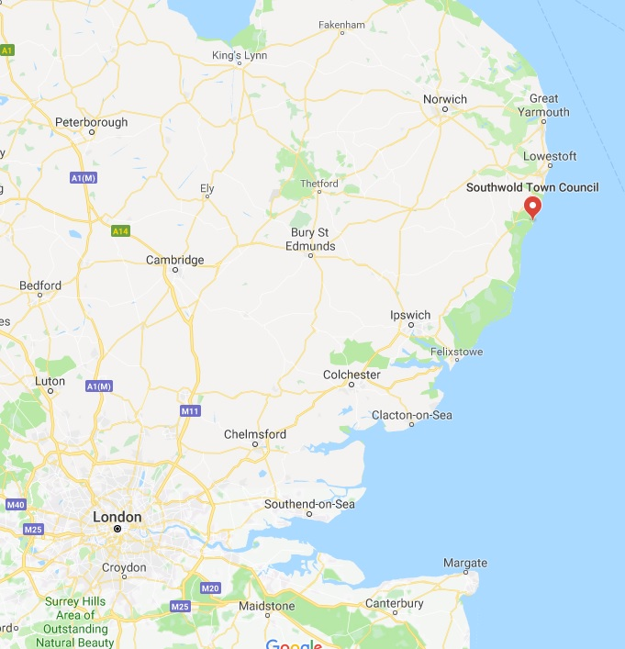
Southwold
Pop 1,100
Suffolk Coast and Heaths AONB
60% second homes
One of oldest pop in UK.

Slide 4
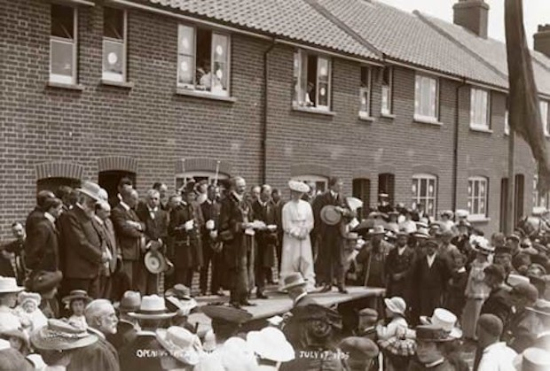
Heritage
Used to have 170 social homes.
Now only has 88

Slide 5
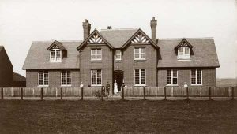
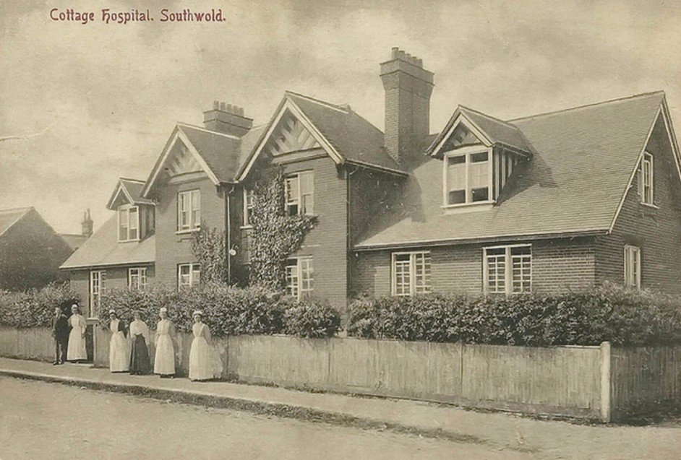
The Heritage
Hospital opened 1903.
Local community at its heart.

Slide 6
The Context
Nov 2015: Southwold Community Hospital closed.
Expected sale was for market housing (95% second homes)
Asset registered as an Asset of Community Value (won against NHS appeal).

Slide 7
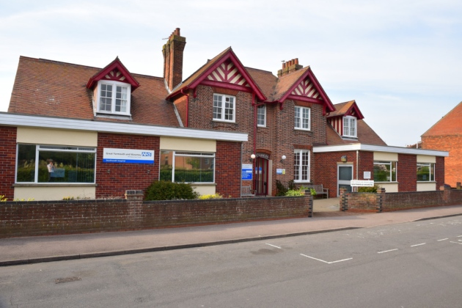
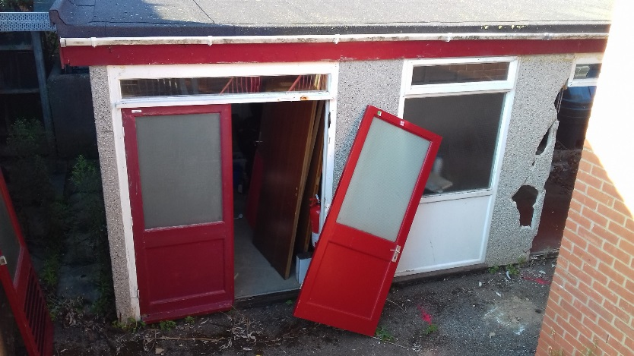
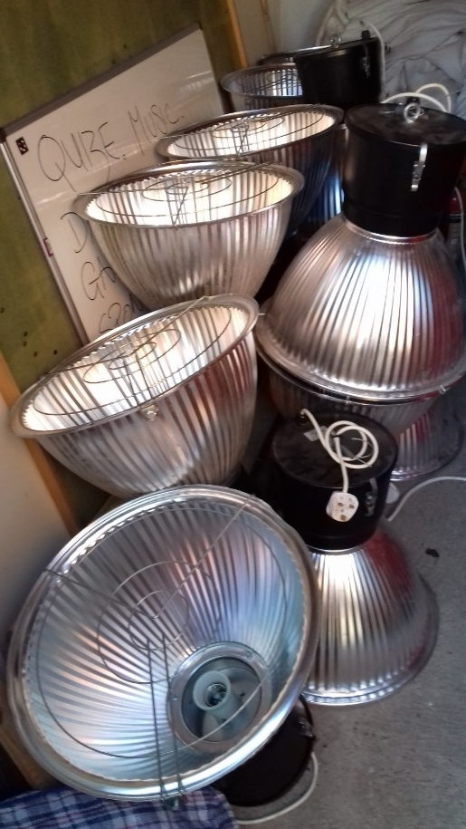
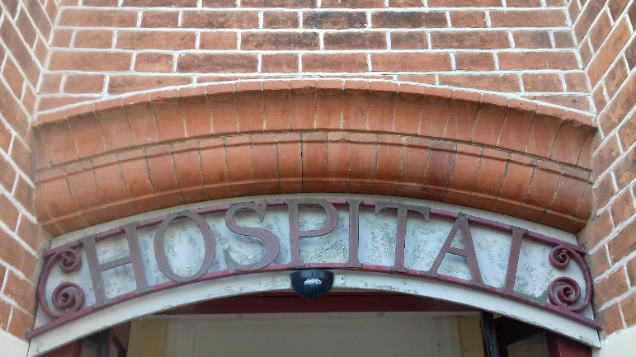
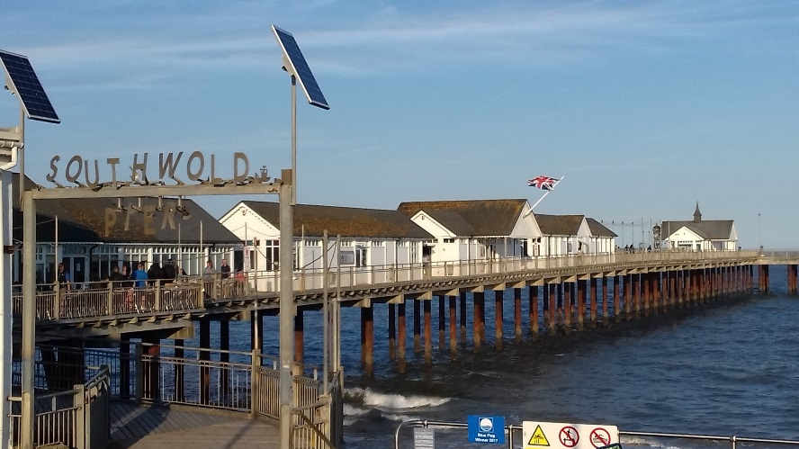
Southwold Hospital Today

Slide 8
The Solution
Community Benefit Society (known as SouthGen) formed 2016.
Partnered with Hastoe to buy site as ACV.
Purchased in March 2018 for £935,000.
First community hospital bought back for community use.

Slide 9
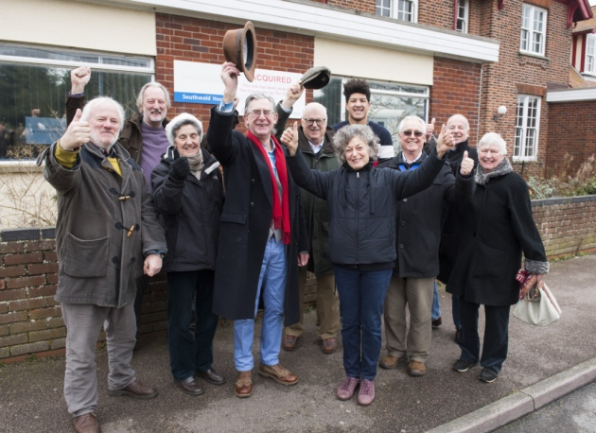
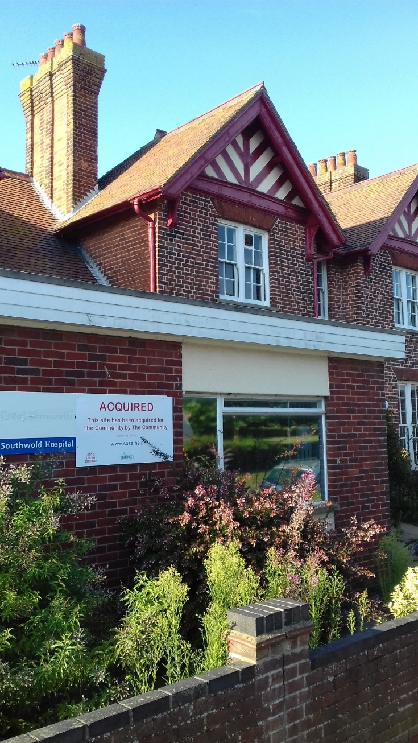
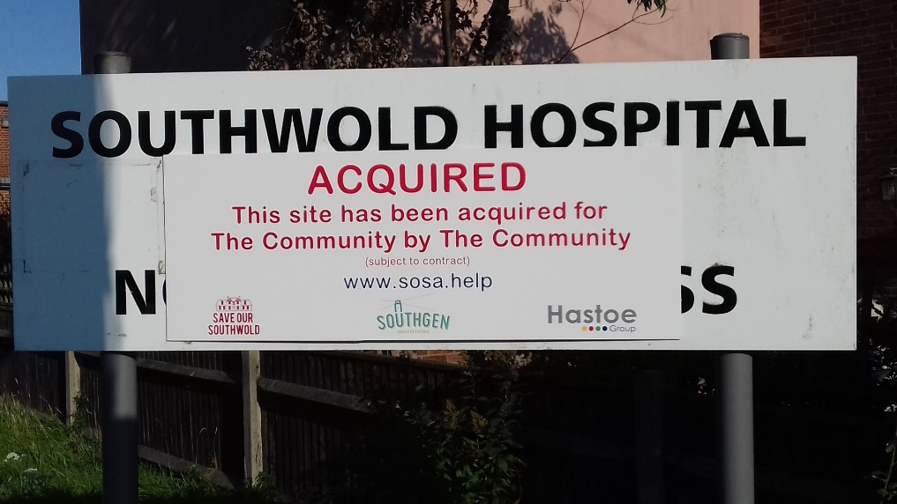
Site Acquired

Slide 10
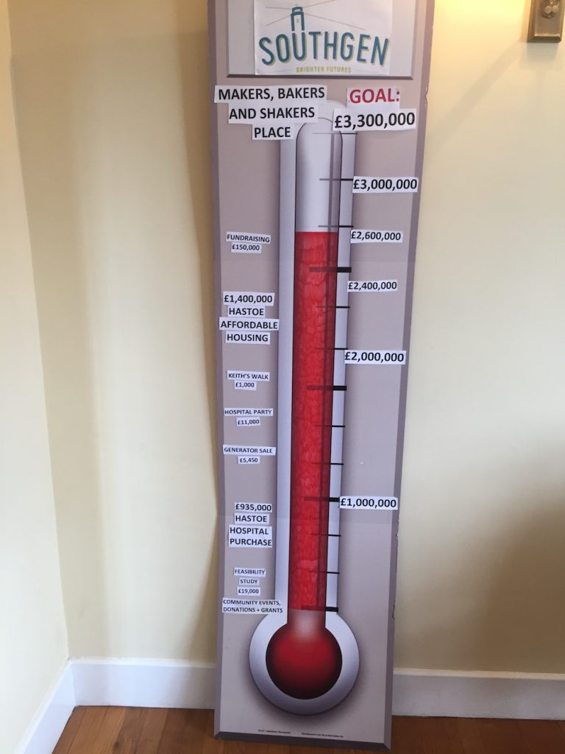
Finances
SouthGen sells freehold to Hastoe
999 Year Lease for Community use element
Total scheme cost of £3.2m
£300k through Community Housing Fund
Tenure Mix – 4 Affordable Rent, 5 SO – with grant.

Slide 11
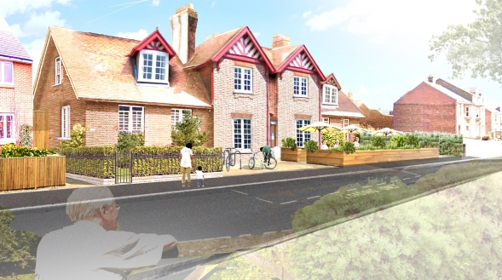
Community Hub

Slide 12
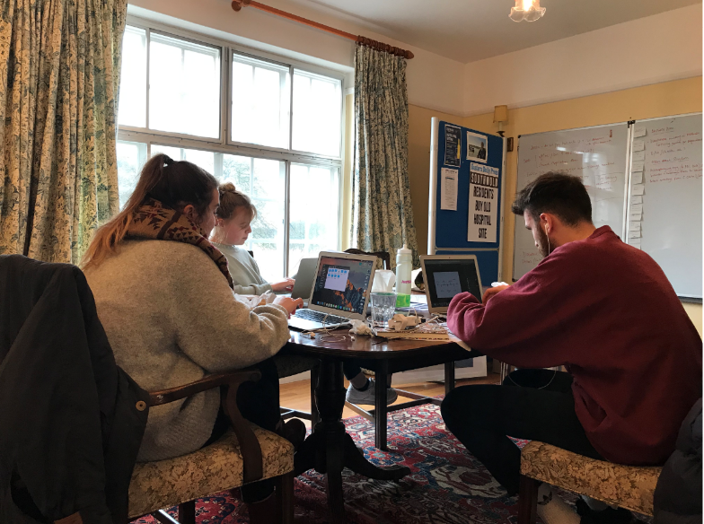
Community Assets
Library + 3 community businesses
  Farm to Fork Café
  Nursery
  Co-Working Space
59% construction costs through Community Business Fund and LEP. Rest through Community Share Offer

Slide 13
Lessons
Community Strength
Community Housing Fund
Assets of Community Value

Slide 14
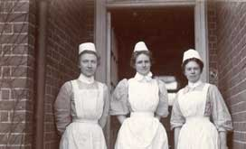
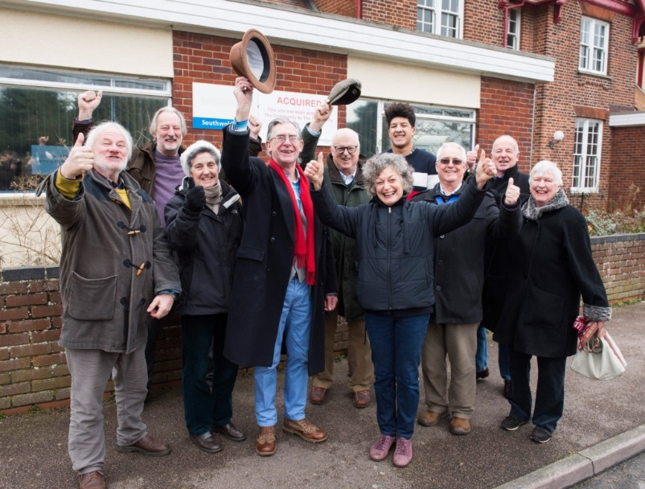
A brighter future?

