Slide 1
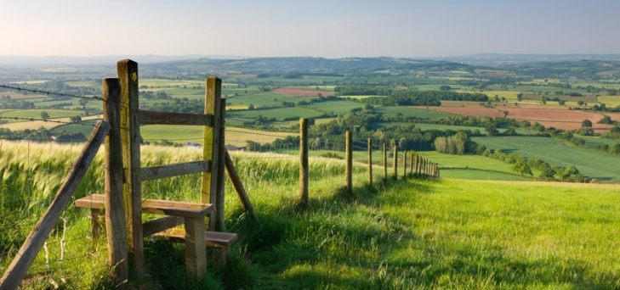
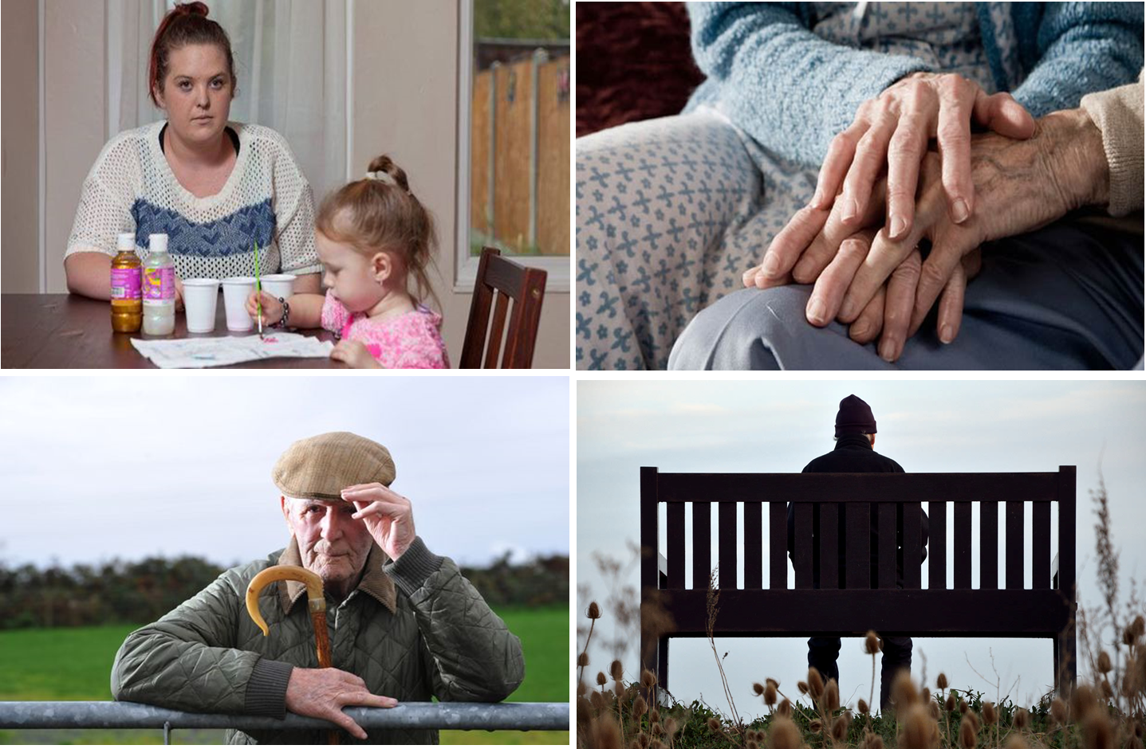

Understanding Rural Vulnerability
Jo Giles
Customer Safeguarding Manager
Customer Performance

Slide 2
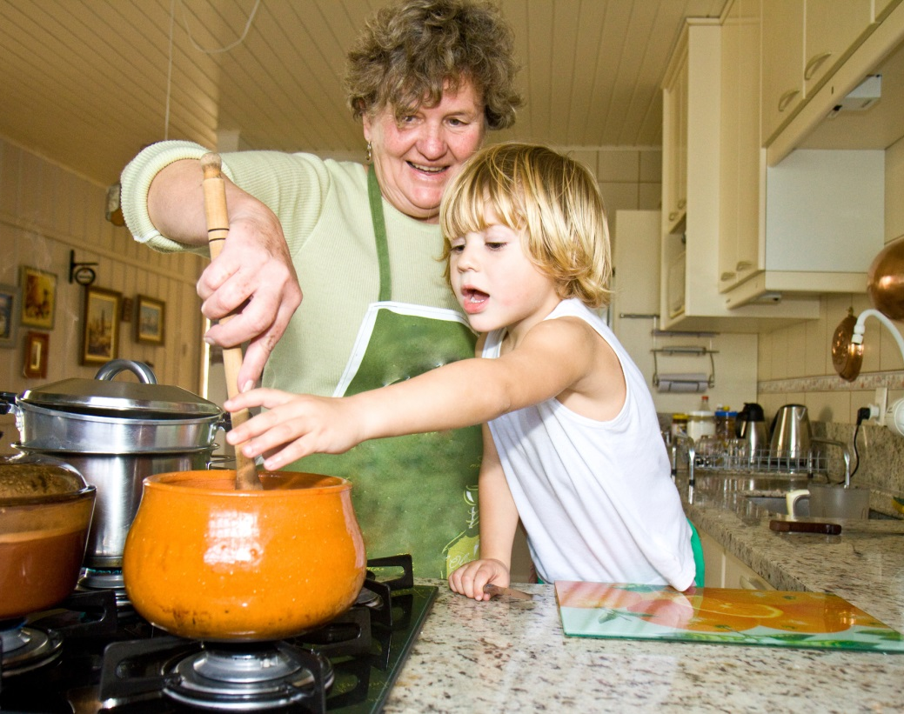
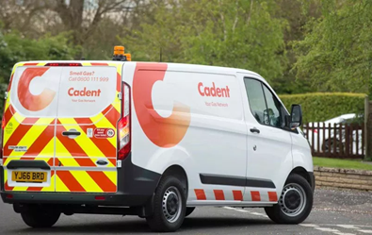
Who is Cadent and what is a gas distribution network?
We connect you to the gas you use
We move gas through our network of pipes, providing gas to your homes
We don’t own or sell gas. This is the role of your gas supplier.
You can choose your gas supplier, but there is only one gas distribution network operating in your area
There are 8 gas distribution networks in the UK. We own 4 of them, making us the largest gas distribution network operator.

Slide 3
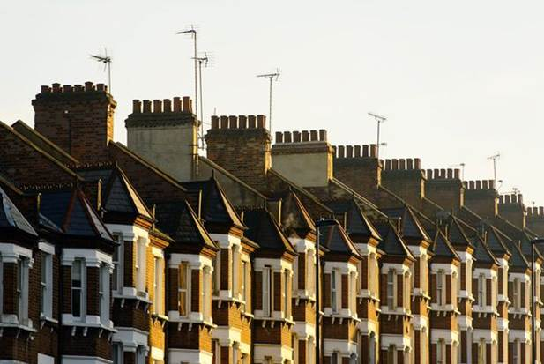
Behind every door..
Supporting our people to respond to what they find

Slide 4

Vulnerability describes a situation, be it transient or permanent that can impact a customer at some point during their life.
Vulnerability can arise through changes that happen both inside and outside the energy industry.
Those customers who find themselves in a vulnerable situation are more affected by Cadent’s action or inaction than other customers.

Slide 5
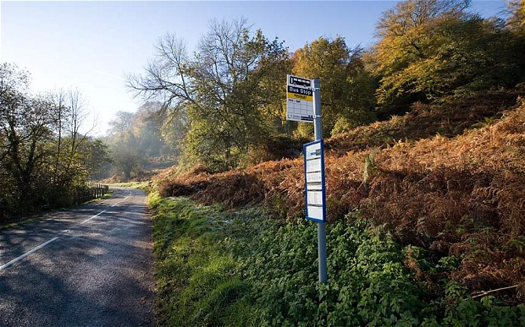
But what happens when..

Slide 6
Our Safeguarding Approach
4. Business as usual
Our Customers
Supportive
Seamless
Respectful
2. Our Partners
Two Way
Informed consent
Connect
3. Tool Kit
2. Referrals
3. Our People
Training
Champions
Innovation
4. Our Processes
On Purpose
Easy/repeatable
Safeguarding Services
1. PSR

Slide 7
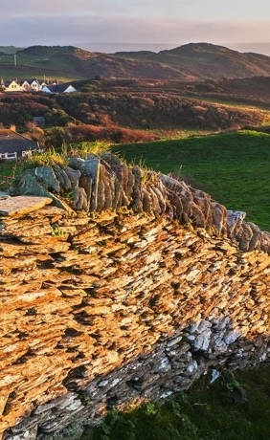
Rural Vulnerability
Compounding factors
Variances and extremes within rural
Impacts of external factors
  Aging population
  Living alone
Infrastructure & access issues
  Housing stock
  Reducing services

Slide 8
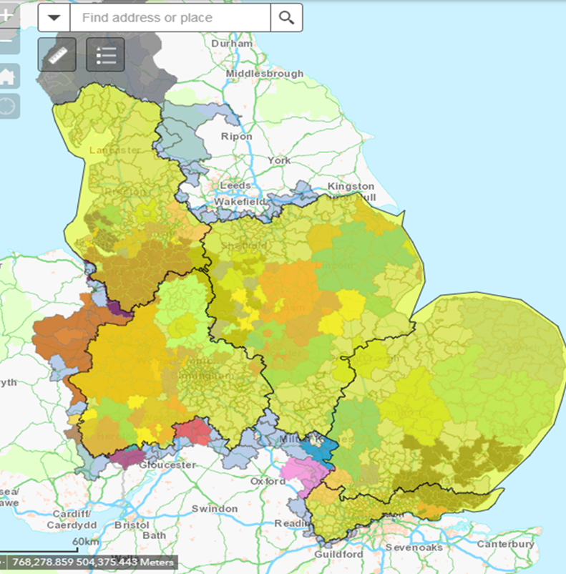

Local feel
Greater and more relevant outcomes
CSE data mapping
Referral Systems
Partnership strategy
Research and customer forums
Safeguarding Service Innovation
Resilience & supporting self-resilience

Slide 9
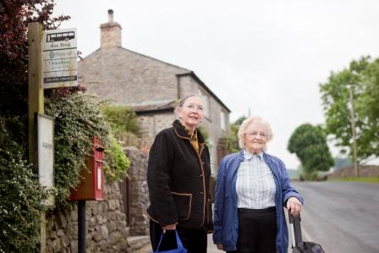
Thank you
Working together to keep customers safe, warm and independent in their homes

