Slide 1

Moving towards Rural Vibrancy
Mike Axon

Slide 2


Slide 3
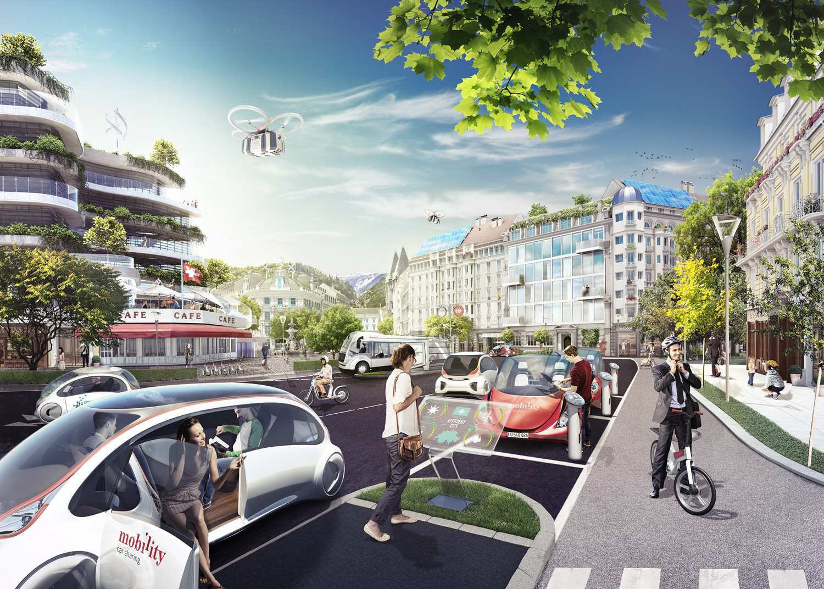
Mobility

Slide 4

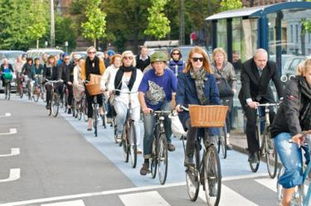
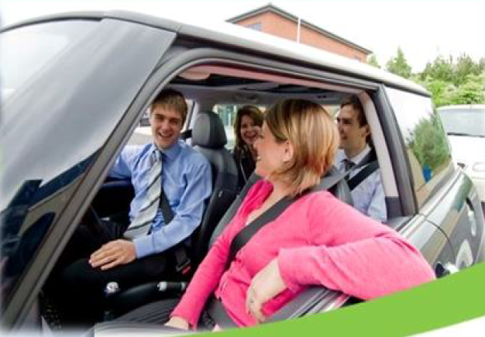

Mobility hierarchy

Slide 5
Virtual Mobility

Slide 6
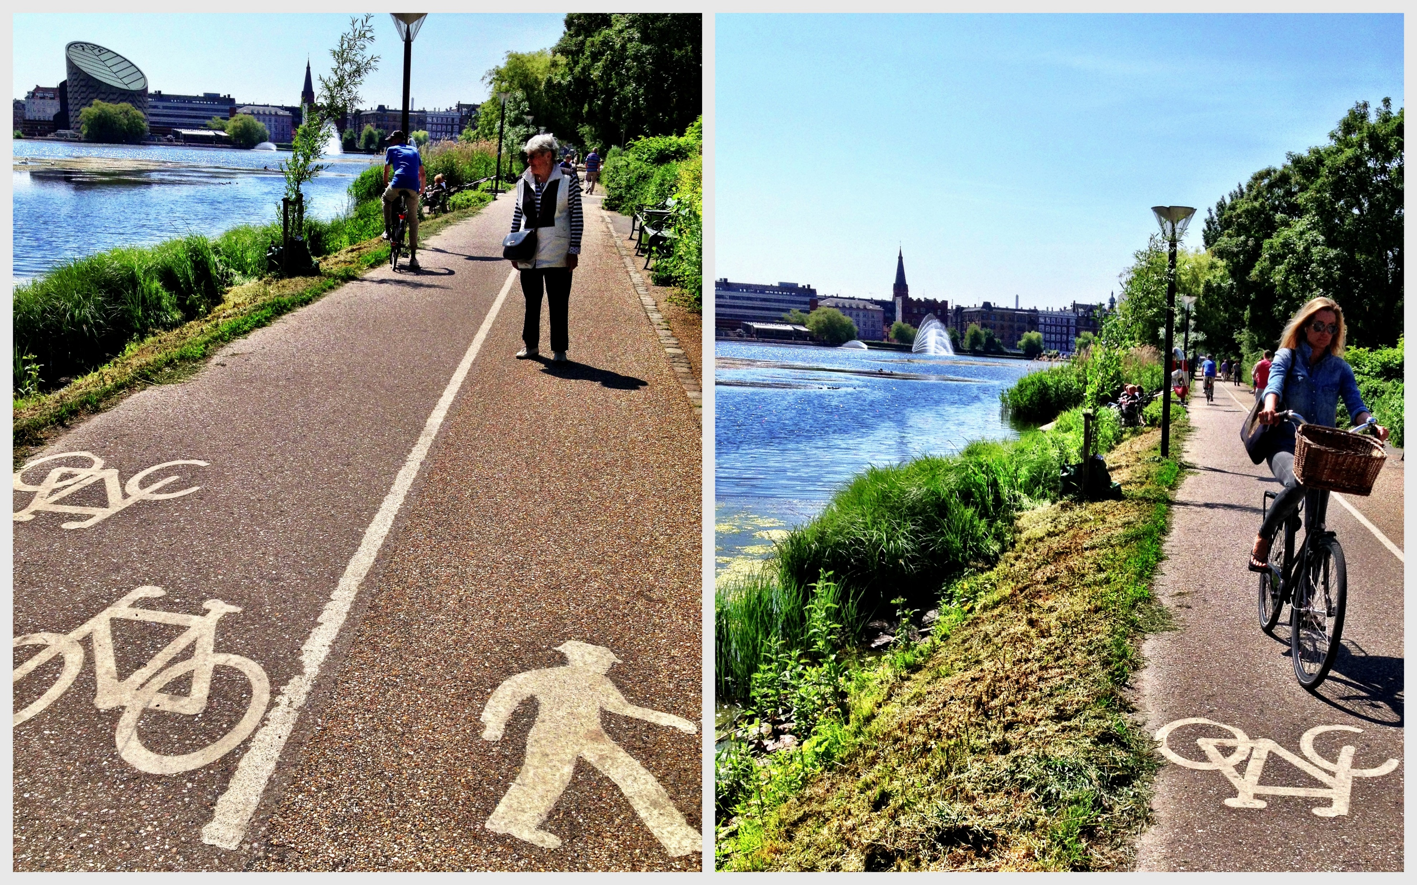
Active Travel - walking and cycling

Slide 7

Shared Travel

Slide 8
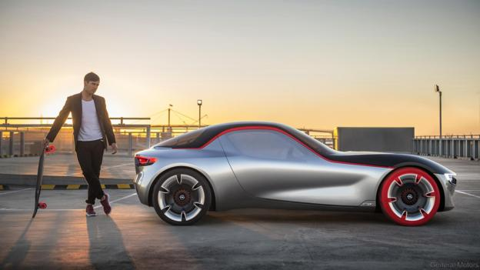
Single Occupancy Vehicles

Slide 9

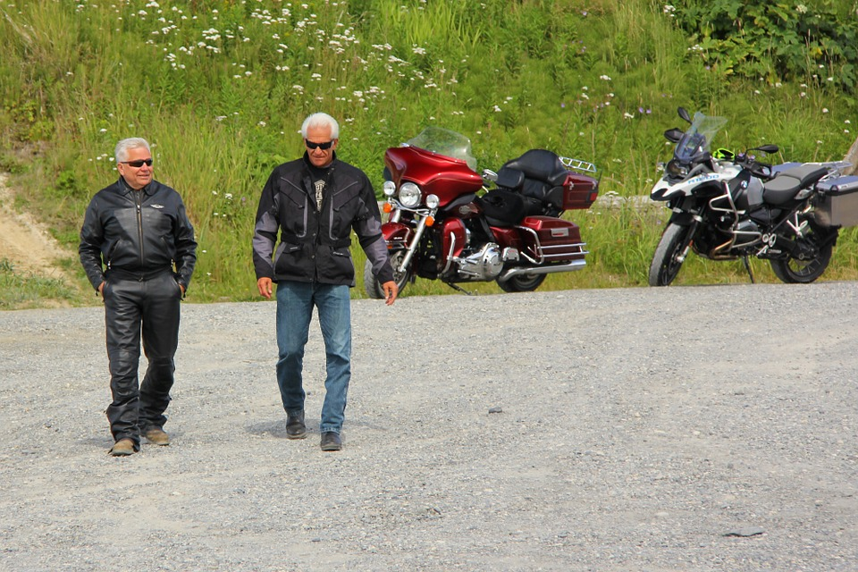
The growing demand for sharing – generational
Wealth of research proves younger generation less interested in ownership
Convenience is key
Linked to technological advances
Mobility is being rapidly transformed by an increasingly digital society
Time and cost no longer sole factors in mobility choice
Millennials
Most connected generation- social networks, sharing platforms
Shared mobility ‘for me’.
24% likely to use carpool
65% prefer a new smart phone over a new car
Insites 2015
Baby Boomers
Value privacy
Personalised mobility, owned ‘by me’
5% likely to carpool
Insites 2015
Notes:
MAYBE TAKE THIS SLIDE OUT?
Important to provide shared mobility options as younger people much moor likely to share – in order to keep young people in rural communities .
Also in Vectos wider TP Work we are advancing the case for internalisation of new communities … see next slide

Slide 10


Slide 11


Slide 12


Slide 13


Slide 14


Slide 15


Slide 16
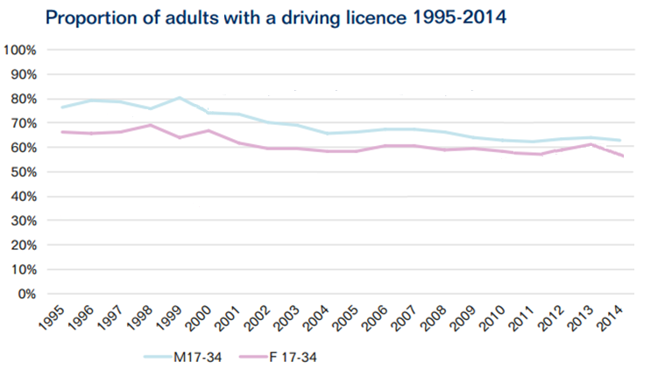
Driving licence

Slide 17
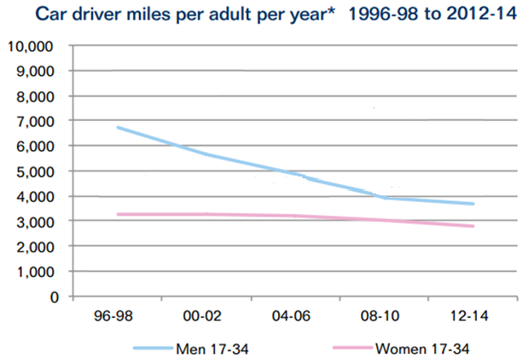
Driver miles

Slide 18
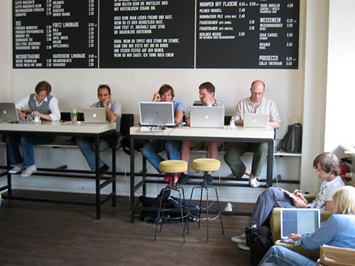
Flexible Working

Slide 19
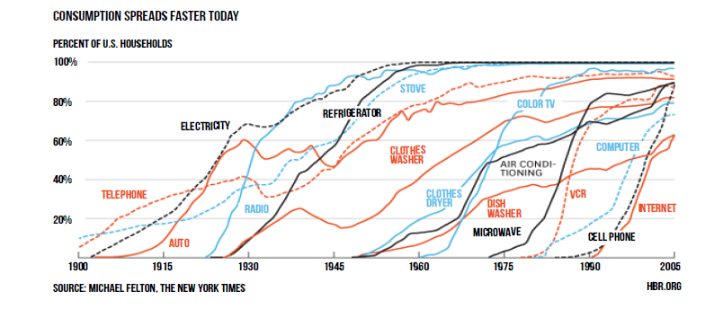
Tech Absorption Rate
Nico Larco, Urbanism Next Center, University of Oregon

Slide 20
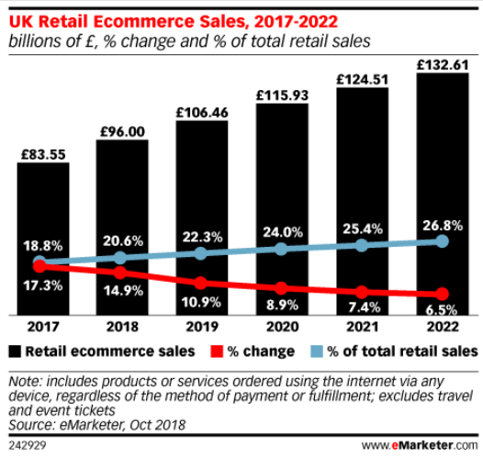
Rise and Fall of e-Commerce and Physical Retail

Slide 21
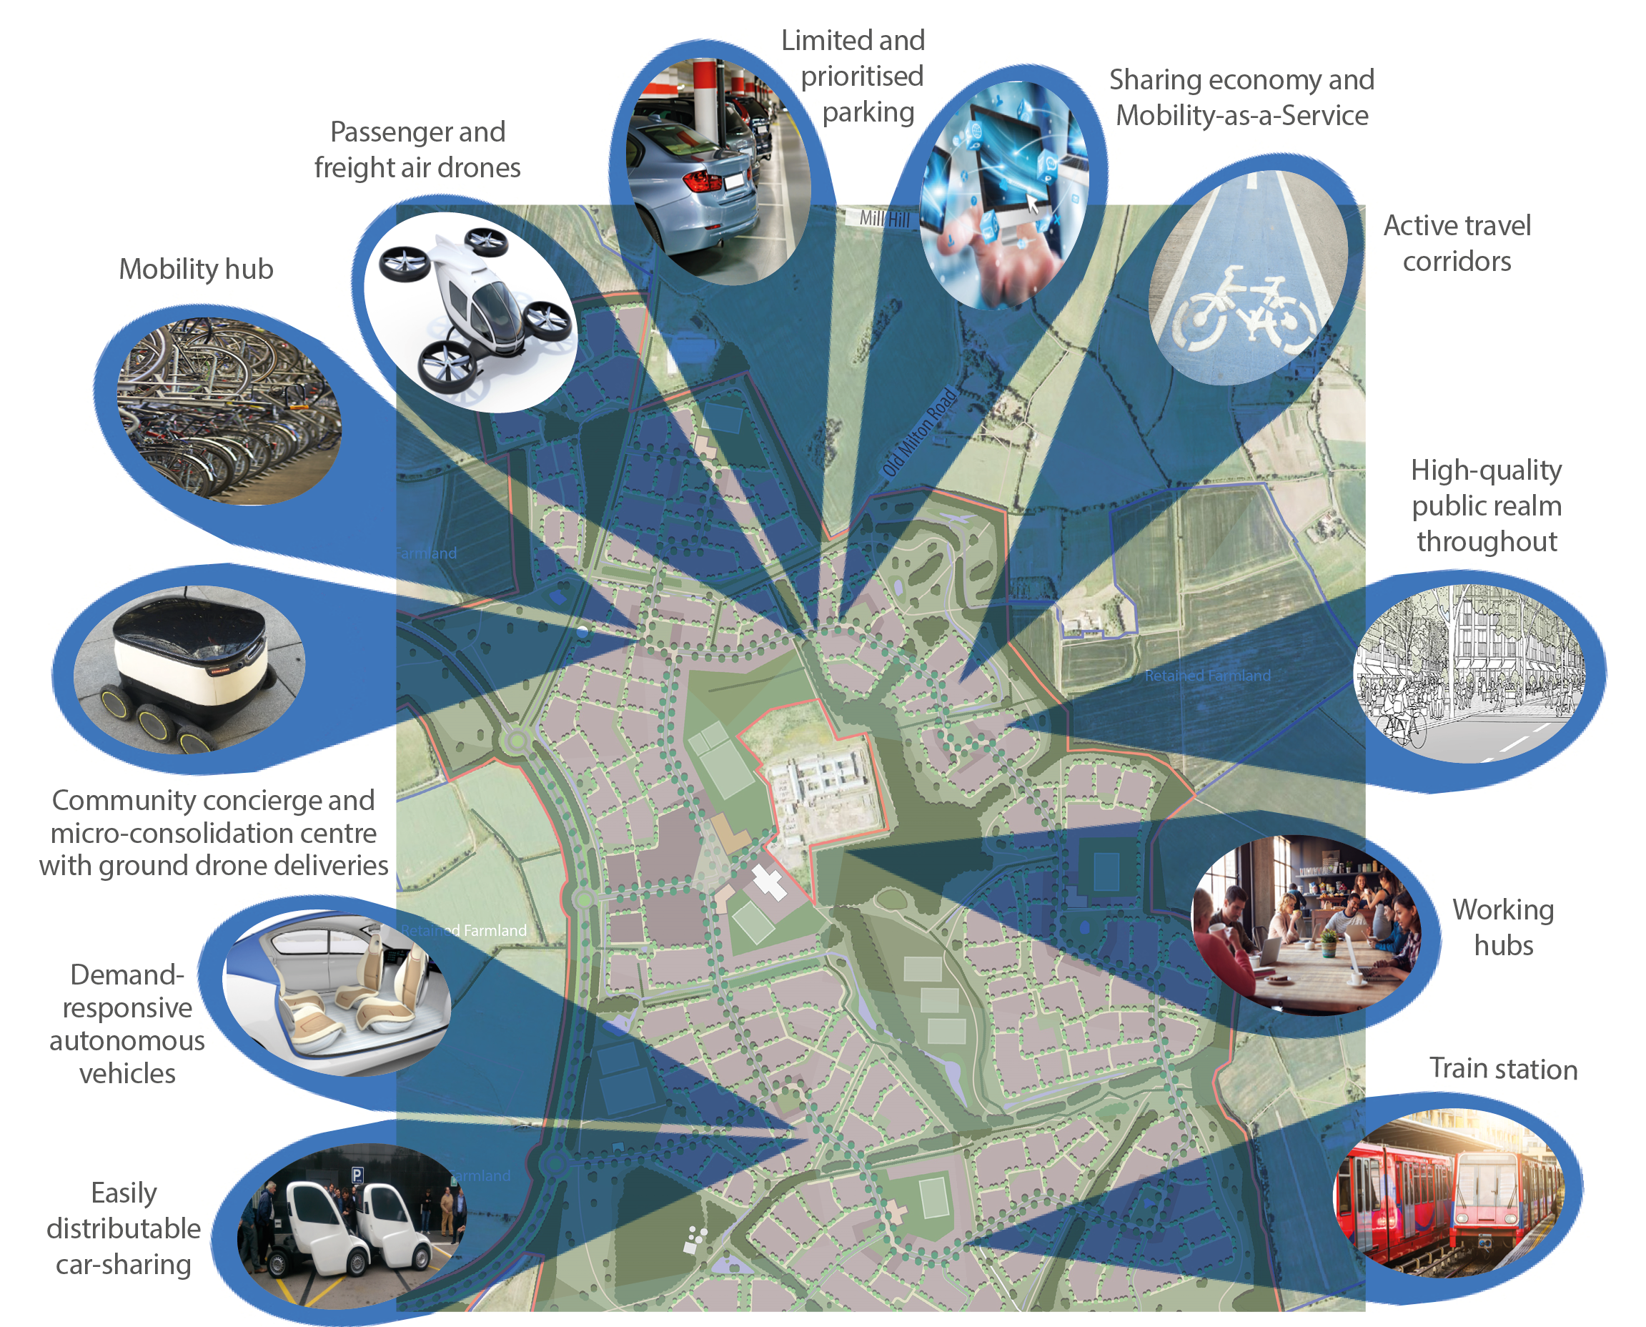
Mobility should be at the heart of placemaking

Slide 22

Community Concierge

Slide 23

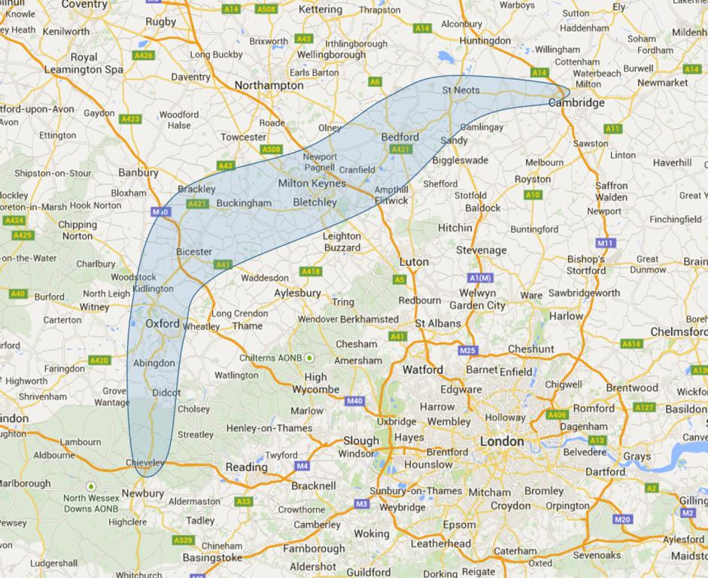
New Settlements

Slide 24
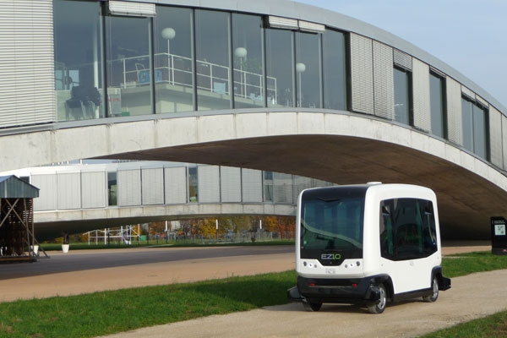

Slide 25
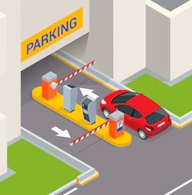

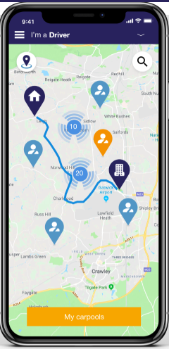
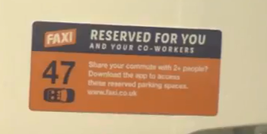


FAXI – carpooling
Users download App
App determines whether there is more than one person in the car
Sends code which is used to open parking barrier to access priority parking.
Users set up digital wallets and top up like Oyster
Up to £1200 tax free income each year for drivers
Northants CC 1700 staff but only 150 parking spaces.
Estimate 670 cars taken off road with new system
More information: https://www.youtube.com/watch?v=jbFSsd13kF0
Notes:
All those downloading the app set up a digital wallet and top up like Oyster. When you are passenger at end of ride, money is transferred auto to the driver’s account. Where parking payment is required, this can also be shared with the passengers.
The main incentive for all users is guaranteed parking, close to building. Can also offer free coffee etc.
Incentive for drivers = up to £1200 tax free income each year (no need to declare to HMRC as it is a “contribution” to journey costs).
Northants Totem cost (to allow access via Bluetooth) was £7k – it was first such model – expect this to come down to less than £1k.
Their route matching algorithm is based on actual journey routes made – they are patenting this tech – so accurate and highlights many more matches than normal.
They have Northants CC as their flagship project: 1700 staff but only 150 spaces. Priority on carpoolers: they think they have taken 670 cars off the road since the new system introduced.

Slide 26




The SMARTA Project
SMARTA is delivering the following free services to support local authorities in improving rural transport connectivity.
Good Practices
Pilots
Workshops
Network of stakeholders
Recommendations
SMARTA Project Partners
The SMARTA project is assessing the challenges and needs of rural communities in providing cost-effective transport and mobility services.
Collates good practices that can be deployed across the UK and other countries:
- on-demand and shared mobility services
- use of new technologies and platforms
- new types of community-based transport systems
- cross-sector partnerships and good governance
- sustainable funding models
The project consortium offers expertise to selected rural sites to pilot, promote and evaluate innovative solutions.
The project will build a network of stakeholders to share these good practices and help the design and implementation of new ones.
Two workshops will be organised to bring together stakeholders to review policy, practice and innovation in the sector
Findings of the research and the pilots will be converted into recommendations for the attention of policy makers
Notes:
2 YEAR PROJECT 2018-2020
One such project is called SMARTA, where we have teamed up with transport and research experts from the UK, Ireland, Italy, Belgium and Romania. We are assessing the specific needs of inhabitants of rural areas and how to improve transport services in a sustainable and cost effective way. This will involve strategies to introduce demand responsive services and new technologies to make shared mobility more convenient.

Slide 27

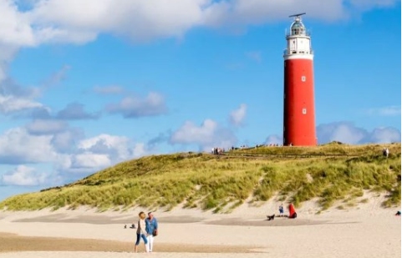
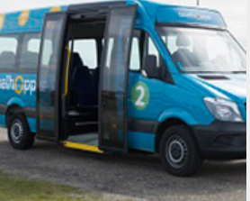


Texelhopper on demand service
Partners involved
During the setting up phase, the PT user association, the tourist agency and 5 local taxi companies were involved as well the municipality and the Province.
Intelligent use of algorithm to allocate users to mini buses which learns from past usage (time/ day) and adapts it if demand is different.
The service should therefore be rather called “demand-influenced” than “on-demand”.
Texel, Northern Netherlands
On demand mini bus service (est 2012), flexible route. Reserve 30 mins in advance online/ by phone to set departure /arrival bus stop. Today 200+ pick up bus stops
More efficient than classic bus service which were slow covering the whole island
Travel with subscriptions, chip pin card or tickets
Island has population of 14,000 but in the summer attracts 900,000 tourists. The latter provide important source of revenue
Last mile and intermodal connections between ferry, train and (mini) bus for school children, commuters to mainland and tourists
Response to loss of rural bus services. Started as 2 year pilot with public subsidy but demand led to continuation. Operations sub contracted to local taxi company
www.texelhopper.nl
Notes:
KEY SUCCESS FACTORS – ALGORITHM TECH
Intelligent use of algorithm to allocate users to mini buses which learns from past usage (time/ day) and adapts it if demand is different.

Slide 28

Nico Larco, Urbanism Next Center, University of Oregon

Slide 29
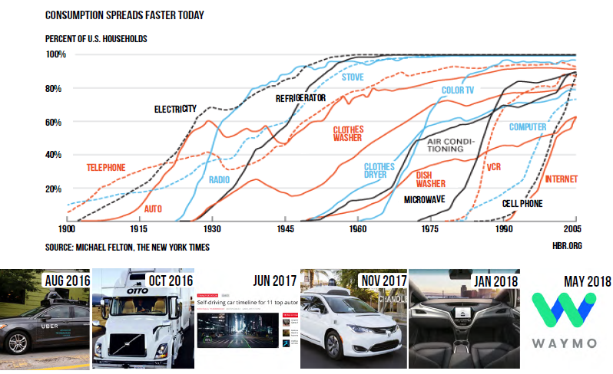
Nico Larco, Urbanism Next Center, University of Oregon

Slide 30
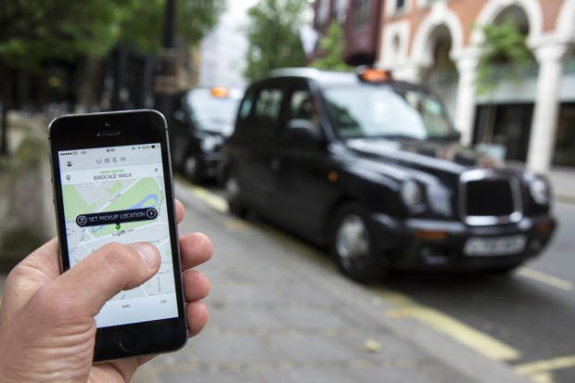
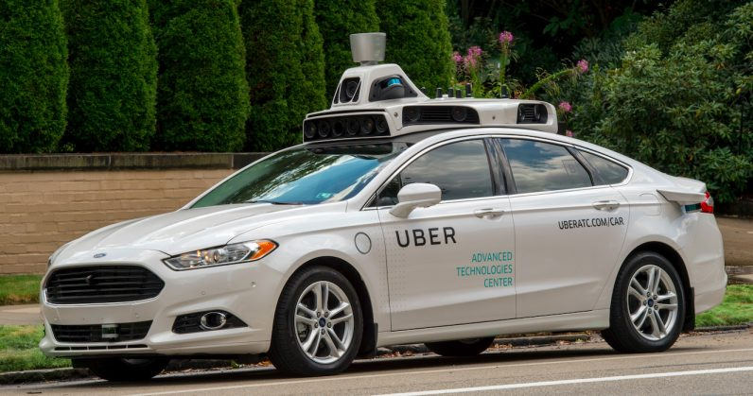
Notes:
https://blogs.spectator.co.uk/2017/01/uber-become-labour-markets-scapegoat/
https://thenextweb.com/insider/2018/01/24/uber-ceos-self-driving-cabs-will-hit-the-streets-by-mid-2019/

Slide 31
Cost of Trips?
Despite high costs and fast depreciation, substantial utilisation can make shared, high-tech “mobility vehicles” economically compelling
Cost per Unit Distance
Source: AAA, NYC Taxi and Limosine Commission “Me, my vehicle, my life in the ultra connected age”.

Slide 32
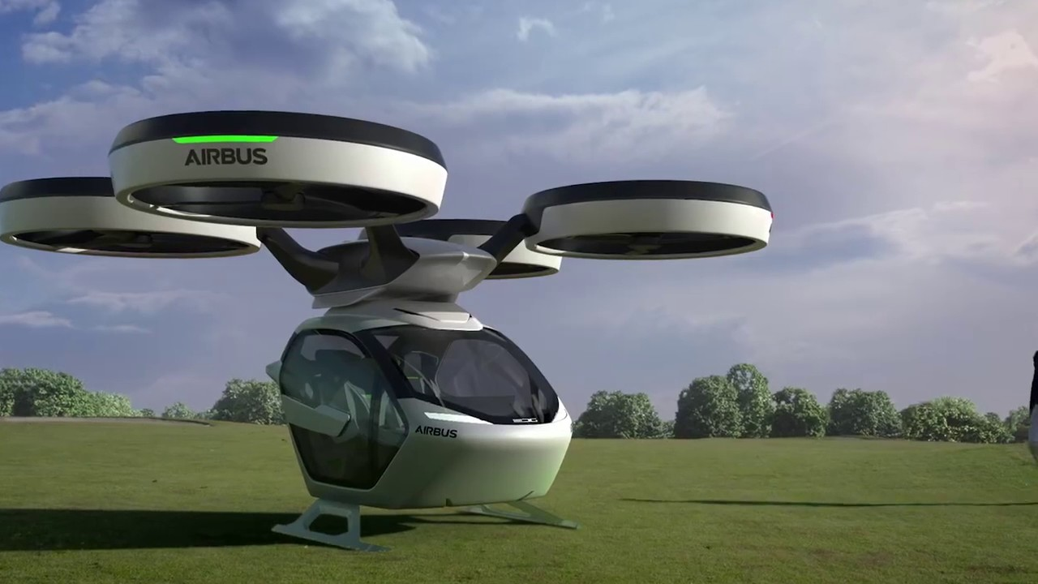
The Future
Notes:
The first testing of drone deliveries has taken place in America. It was carried out by Australian start-up Flirtey, in partnership with Virginia Tech and NASA. They used a drone to carry 10 pounds (4.5 kilograms) of medical supplies from an airfield in Virginia to a remote clinic about a mile away over three 3-minute flights.
In 2013 Amazon announced plans to launch a ‘Prime Air’ delivery drone service by 2015 but so far has only unveiled a prototype. While the demonstration was a landmark moment for drone technology and policy, it is still a long way off Amazon's vision of a fleet of drones delivering online purchases to customers' doorsteps within 30 minutes. But Amazon is still committed to making its drone delivery service a reality and the U.S. Federal Aviation Administration (FAA) has granted the company permission to begin testing its drones.
But Amazon isn't the only tech giant doubling down on drone technology. Google’s drone delivery service, dubbed ‘Project Wing’ is reported to be launching sometime in 2017.
Facebook has revealed that it has completed a full-size version of its solar-powered Aquila drone, which is now ready for testing in the United Kingdom. The huge robotic flier, which has the same wingspan as a Boeing 737 jetliner, is designed to circle around in the stratosphere and use lasers to beam Internet access to the most remote corners of the world.
While these developments grab headlines, they tend to overshadow the real progress being made in the drone industry, experts say. Many companies are leveraging drones' ability to capture high-resolution imagery using tech ranging from regular cameras to laser scanners, leading the FAA to predict that drones will spawn a $90 billion industry within a decade.
As well as transportation drones could help farmers prioritize where to apply fertilizer. They also could help energy companies monitor their infrastructure. Drones could even enable emergency first response teams to quickly map the extent of damage after natural disasters. And because the technology is still in its infancy, the potential is limitless.

